Slide 1
Manager Tasks and Outcomes: Timekeeping and Basic Scheduling
Notes:
!

Slide 2
Navigation
1

Slide 3
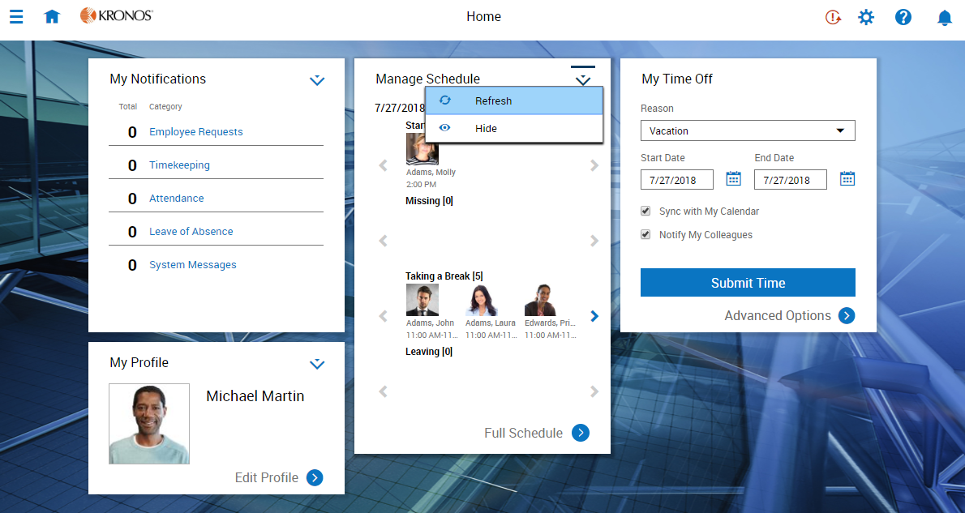
Home page tiles
Tile options menu
Tile Library icon
Home page icon
Access
Main Menu
Take actions directly in this tile
Click to view tile source

Slide 4
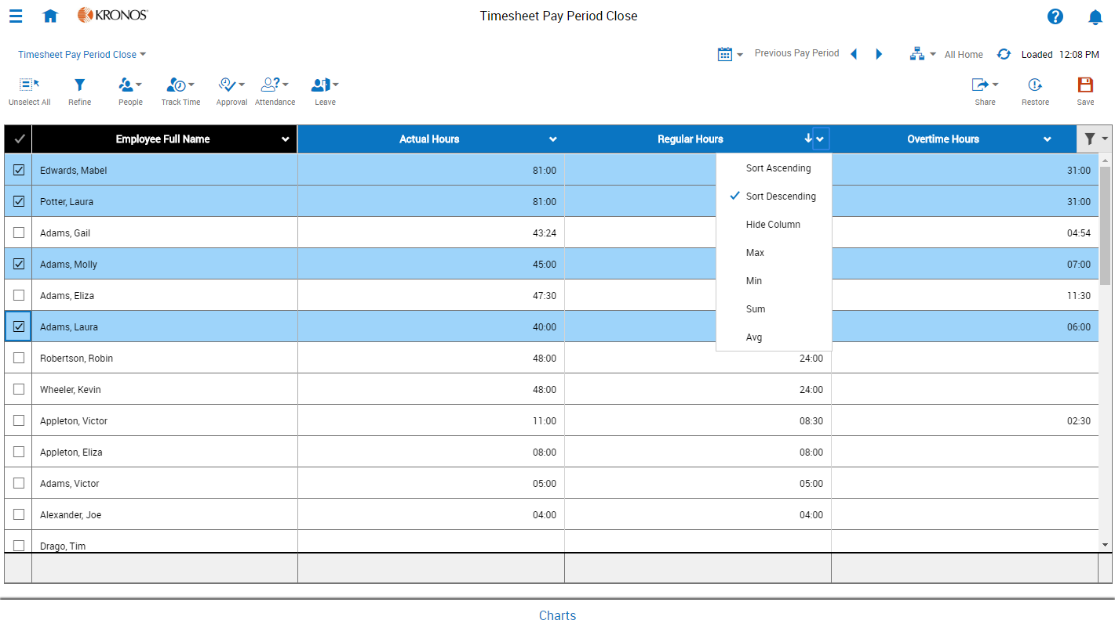
Dataviews
Context options
Dataview selector
Click to save personalizations
Available actions
Filter columns
Column options
Take action on multiple selected employees
Click to view or create charts

Slide 5
Chart tiles
Chart type options
Data options
Previously-created chart

Slide 6
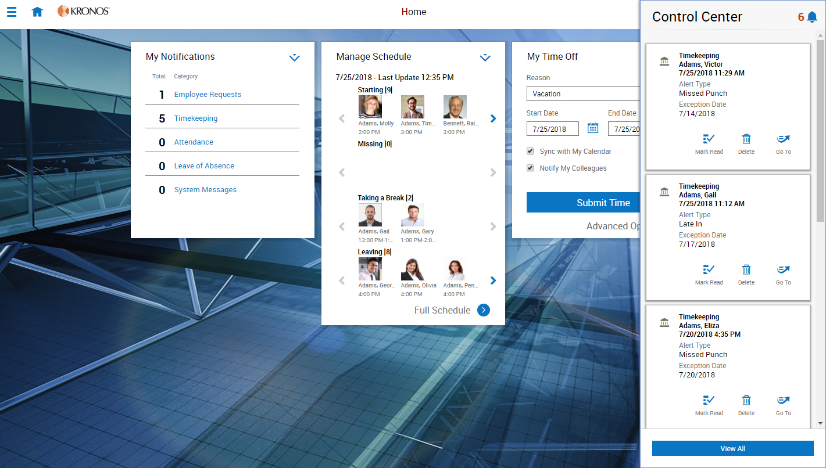
Alerts
Bell icon
Quick actions
Click anywhere to close Control Center panel
Click to open Control Center

Slide 7
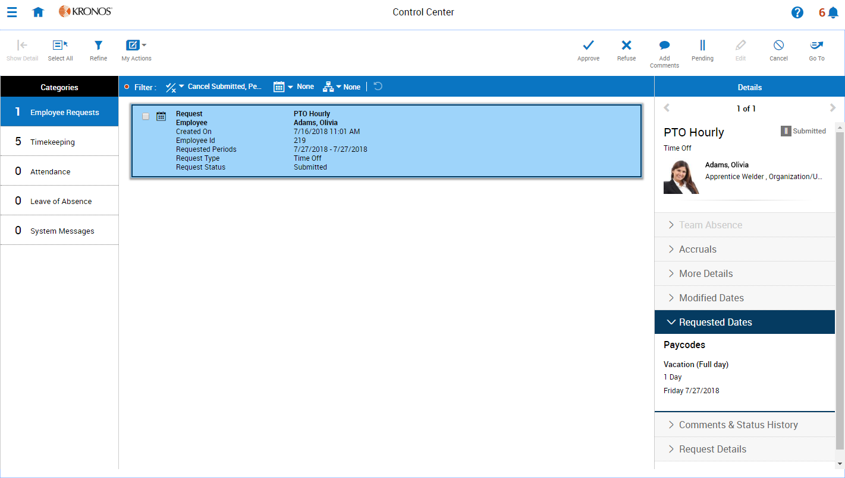
Control Center
Available actions
Filters
Notification list
Details panel
Categories

Slide 8
Scheduling
3

Slide 9
Schedule patterns
Often, employees work the same hours and days of the week. Pattern templates allow you to assign a specified rotation of shifts to one or more employees, so that those shifts automatically populate their schedules.

Slide 10
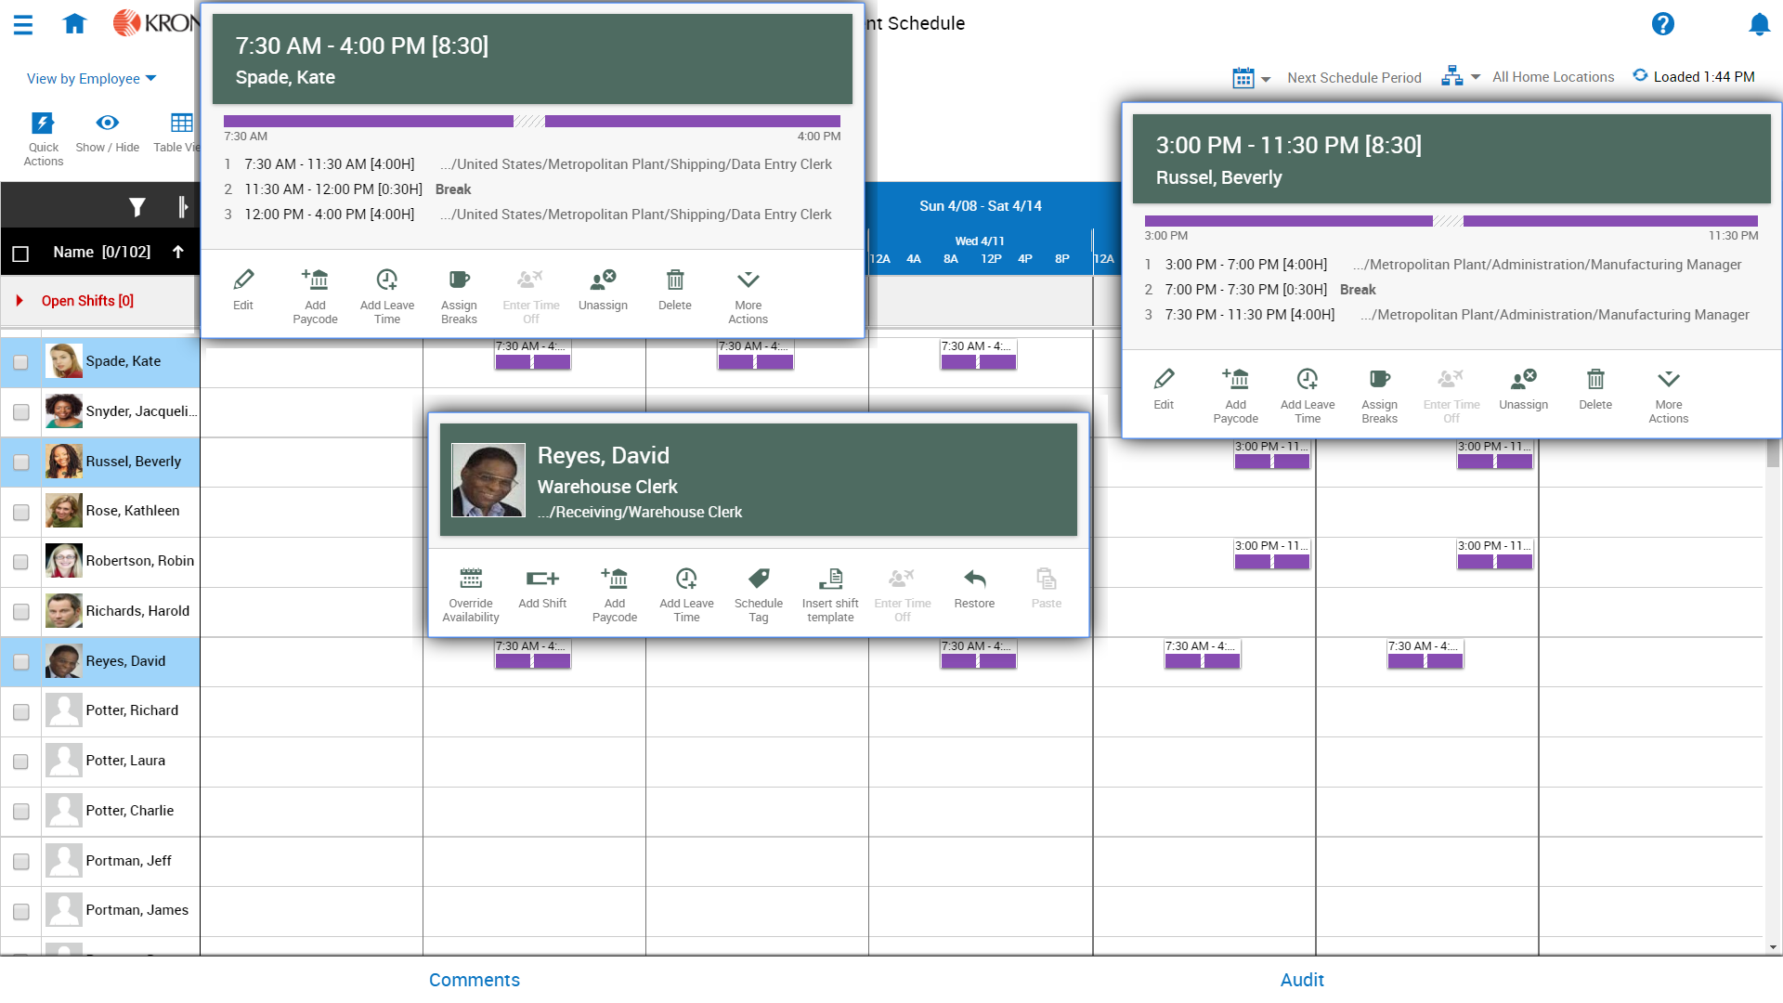
Editing, adding, and deleting shifts
Edit a shift
Delete a shift
Add a shift

Slide 11
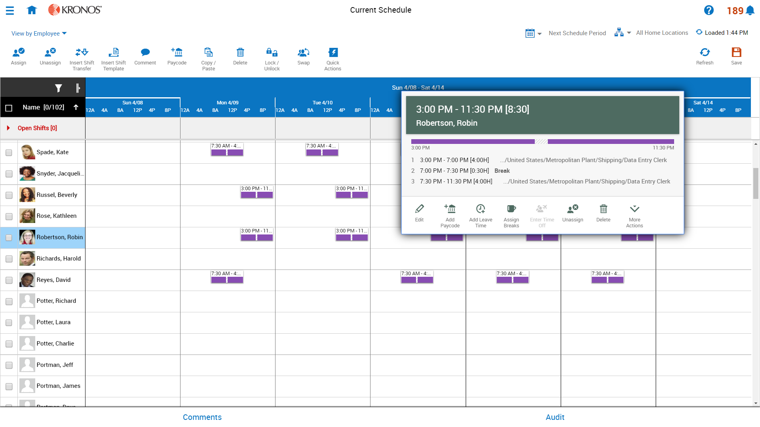
Adding paycodes
Quick action paycode option
Glance paycode option

Slide 12
Performing Transfers
Business Structure transfer
Business Structure XX
Cost Center transfer
Employee
Business Structure XX
Cost Center 1356
Day Shift Work Rule
Labor Category Testing
Work Rule transfer
Labor Category transfer

Slide 13
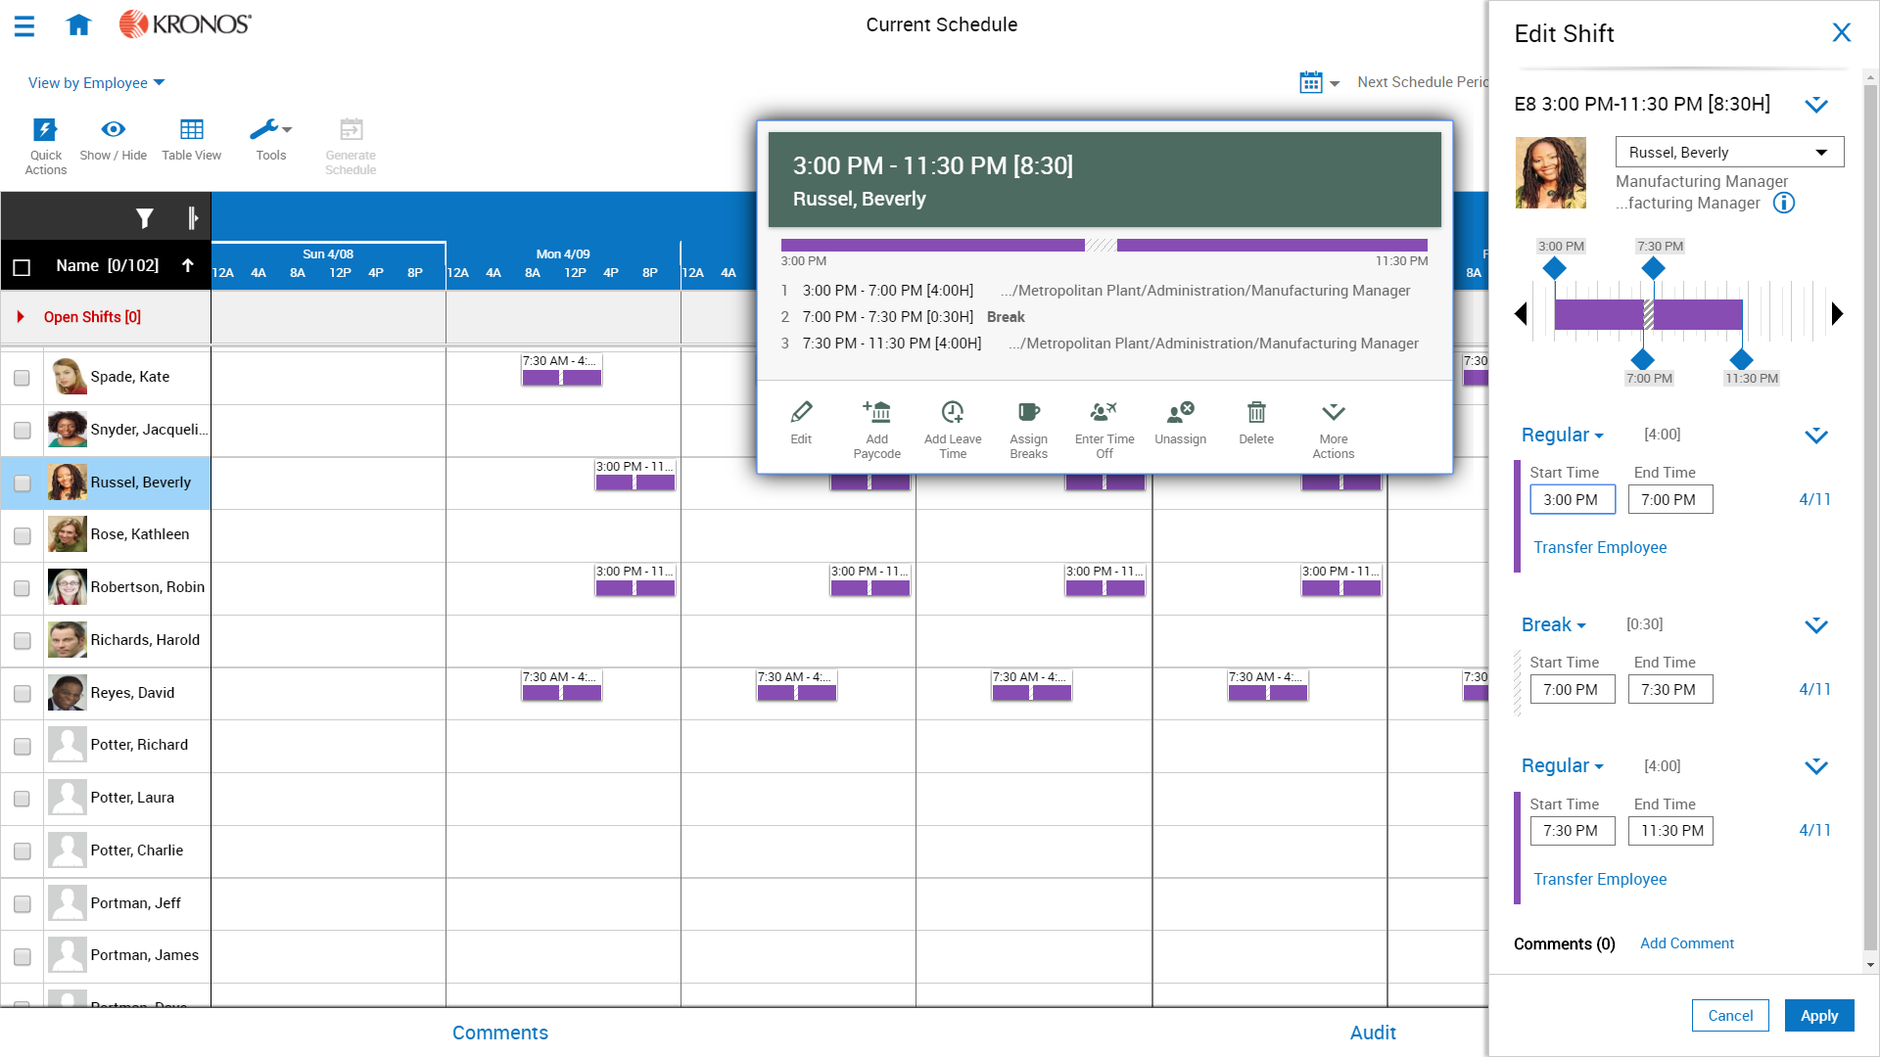
Transferring shifts
Transfer
shift / hours

Slide 14
Timekeeping
4

Slide 15
Scenario
The current pay period is about to close, so along with Michael’s day-to-day activities, he is readying timecards for payroll processing.

Slide 16
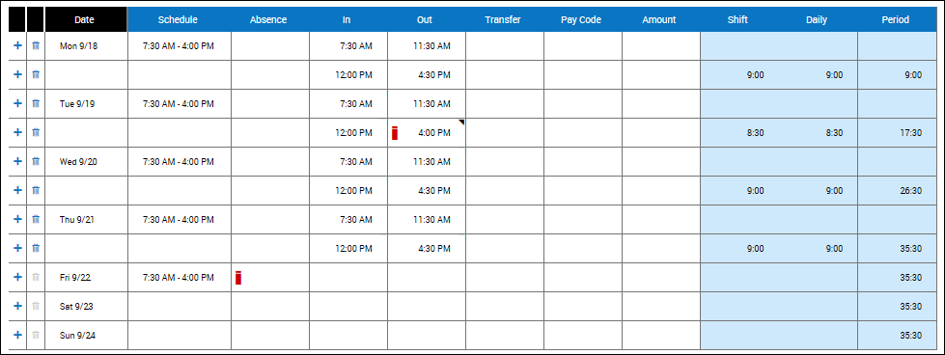
Hourly timecards: Adding, editing, and deleting punches
Delete a row of punches
Delete a punch
Edit a punch
Add a missing punch

Slide 17
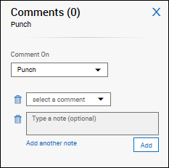
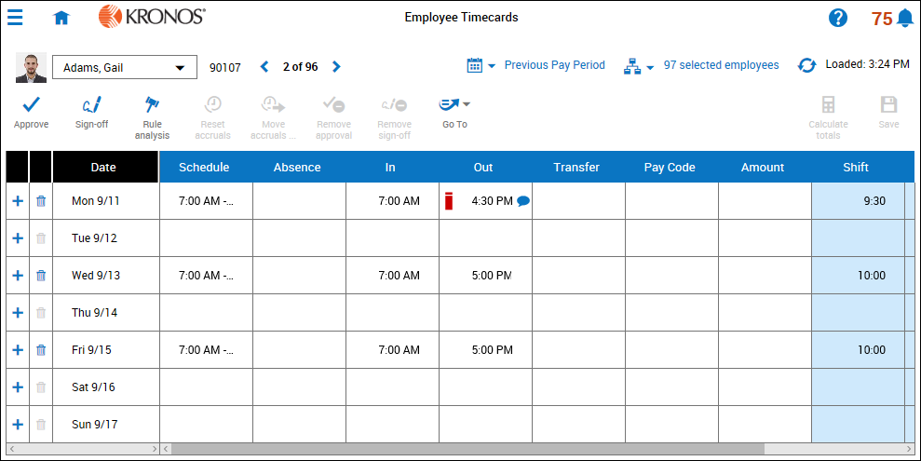
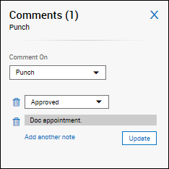
Adding and deleting comments
Add a comment and note
Delete a comment or note

Slide 18
Adding, editing, and deleting paycodes
Add a paycode
Delete a paycode
Edit a paycode

Slide 19
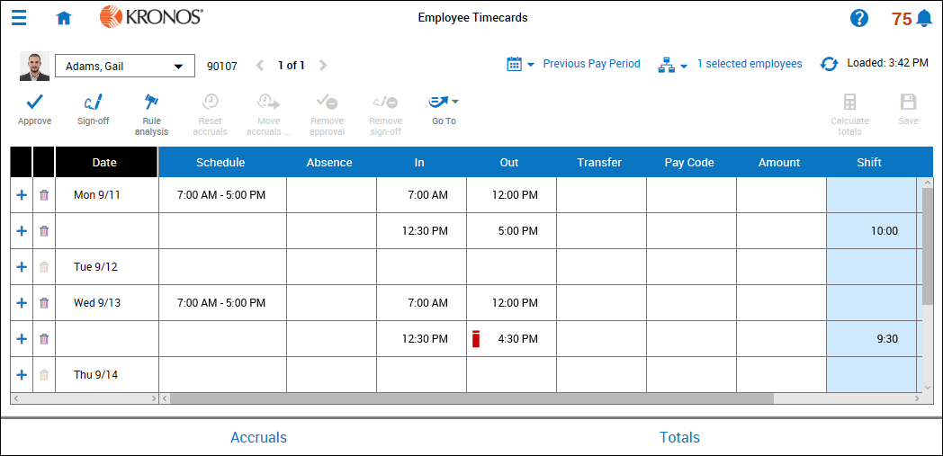
Working with Exceptions
To resolve an exception, you can..
Mark the exception as reviewed and add a comment.
Edit the punch and add a comment.
Add or delete a pay code
Short Shift exception

Slide 20
Performing transfers
Transfer hours

