Slide 2
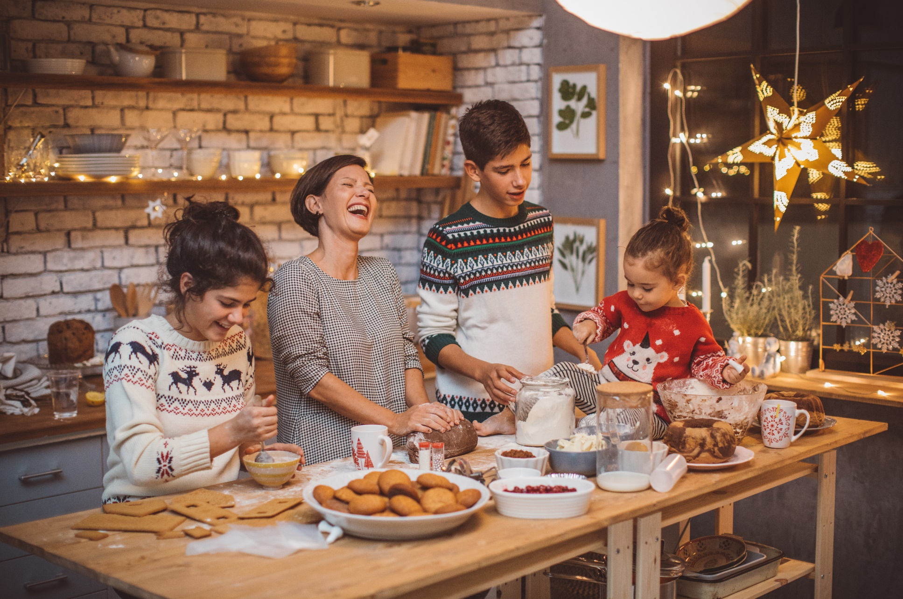
The winter holidays are a mixed bag.
Days off.
Holiday food.
Visiting family members.
Fatigue.
Frustration.
Added responsibilities.
More work.
Visiting family members.
Copyright ©2019 by SafeStart. All rights reserved. SafeStart is a registered trademark of Electrolab Limited.

Slide 3
How can anything bad happen over the holidays?
Mix of excitement, frustration, rushing and fatigue:
We are more likely to ignore certain warning signs.
Act unsafely around hazards.
Copyright ©2019 by SafeStart. All rights reserved. SafeStart is a registered trademark of Electrolab Limited.

Slide 4
The result?
Every winter there is a sudden rise in injuries and fatalities caused by decorating, fires, car accidents, and lifting heavy packages and suitcases.
Protect your loved ones this holiday season.
Copyright ©2019 by SafeStart. All rights reserved. SafeStart is a registered trademark of Electrolab Limited.

Slide 5
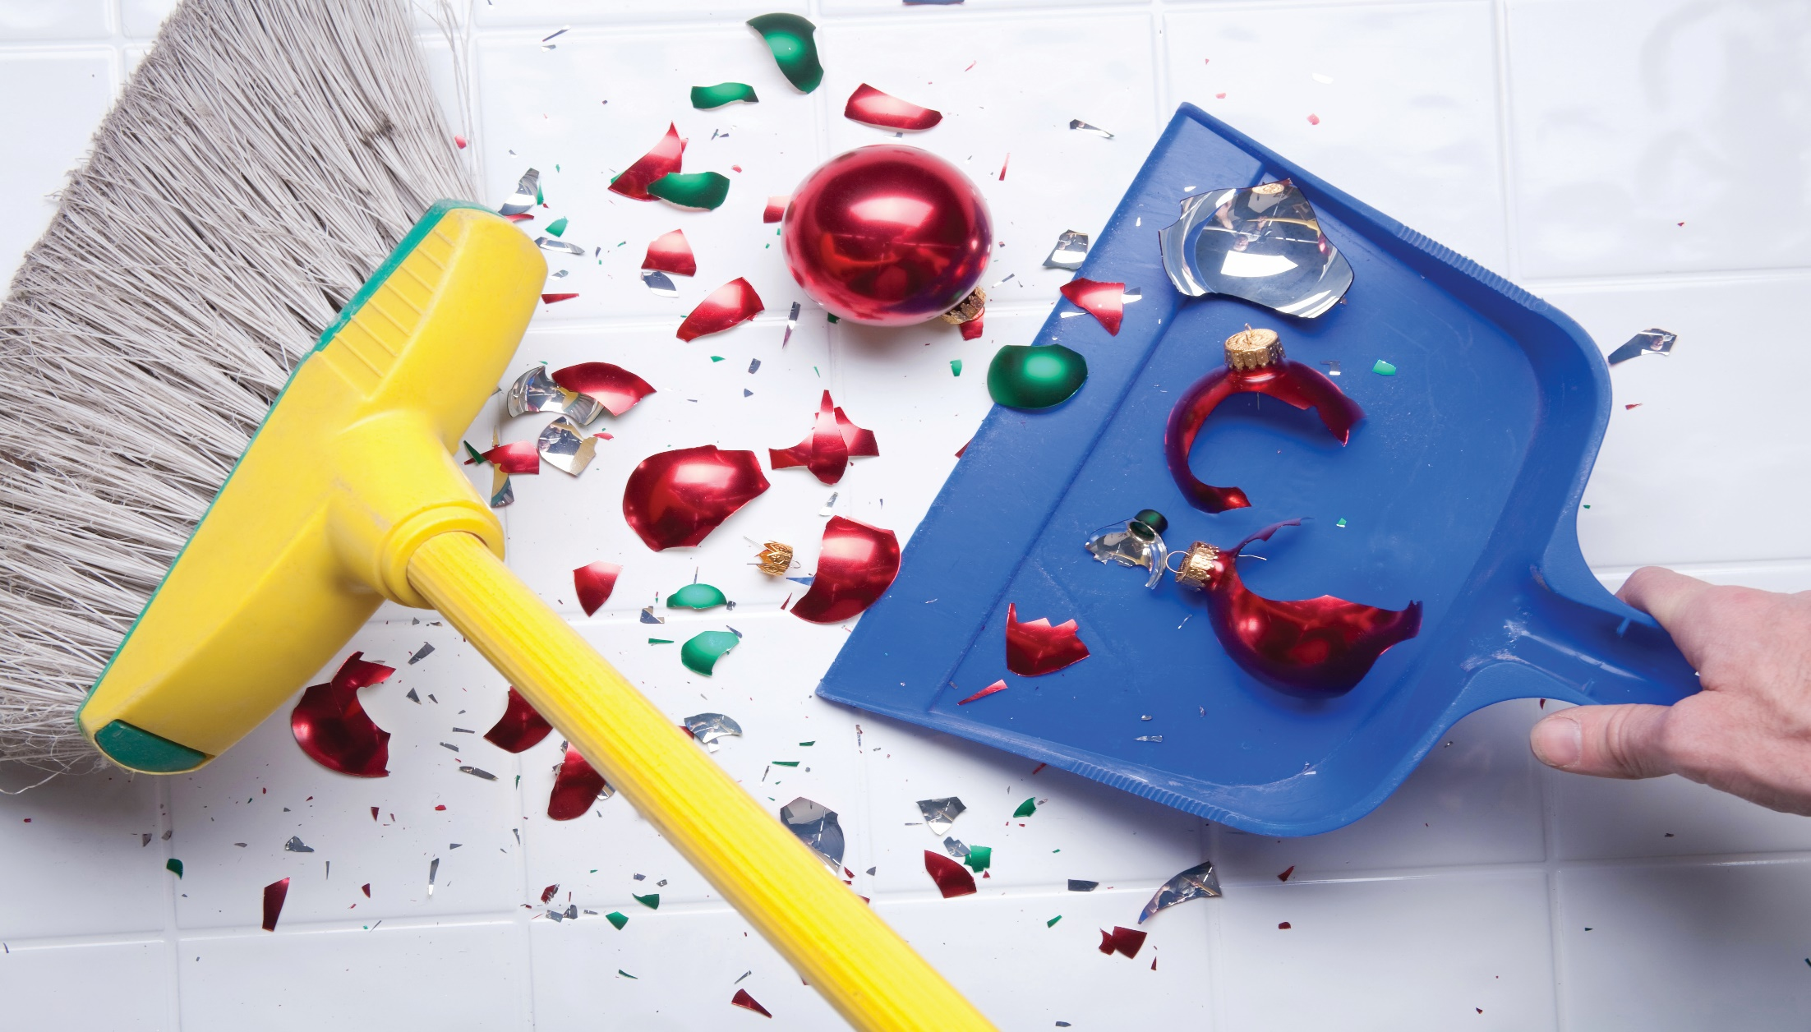
About 200 people a day suffer decoration-related injuries each November and December:
fractures
concussions
muscle pulls
bruises
Source: health.usnews.com
Copyright ©2019 by SafeStart. All rights reserved. SafeStart is a registered trademark of Electrolab Limited.

Slide 6
Most of these injuries are caused by falls from ladders.
Don’t decorate when tipsy.
Have someone help you.
Follow safe ladder use rules.
Copyright ©2019 by SafeStart. All rights reserved. SafeStart is a registered trademark of Electrolab Limited.

Slide 7
Thousands of people are treated each holiday season after sustaining an electric shock.
Inspect your lights for signs of wear and tear.
Follow the proper use and care of your decorations.
Don’t overload sockets.
Source: www.henderson-law.com
Copyright ©2019 by SafeStart. All rights reserved. SafeStart is a registered trademark of Electrolab Limited.

Slide 8
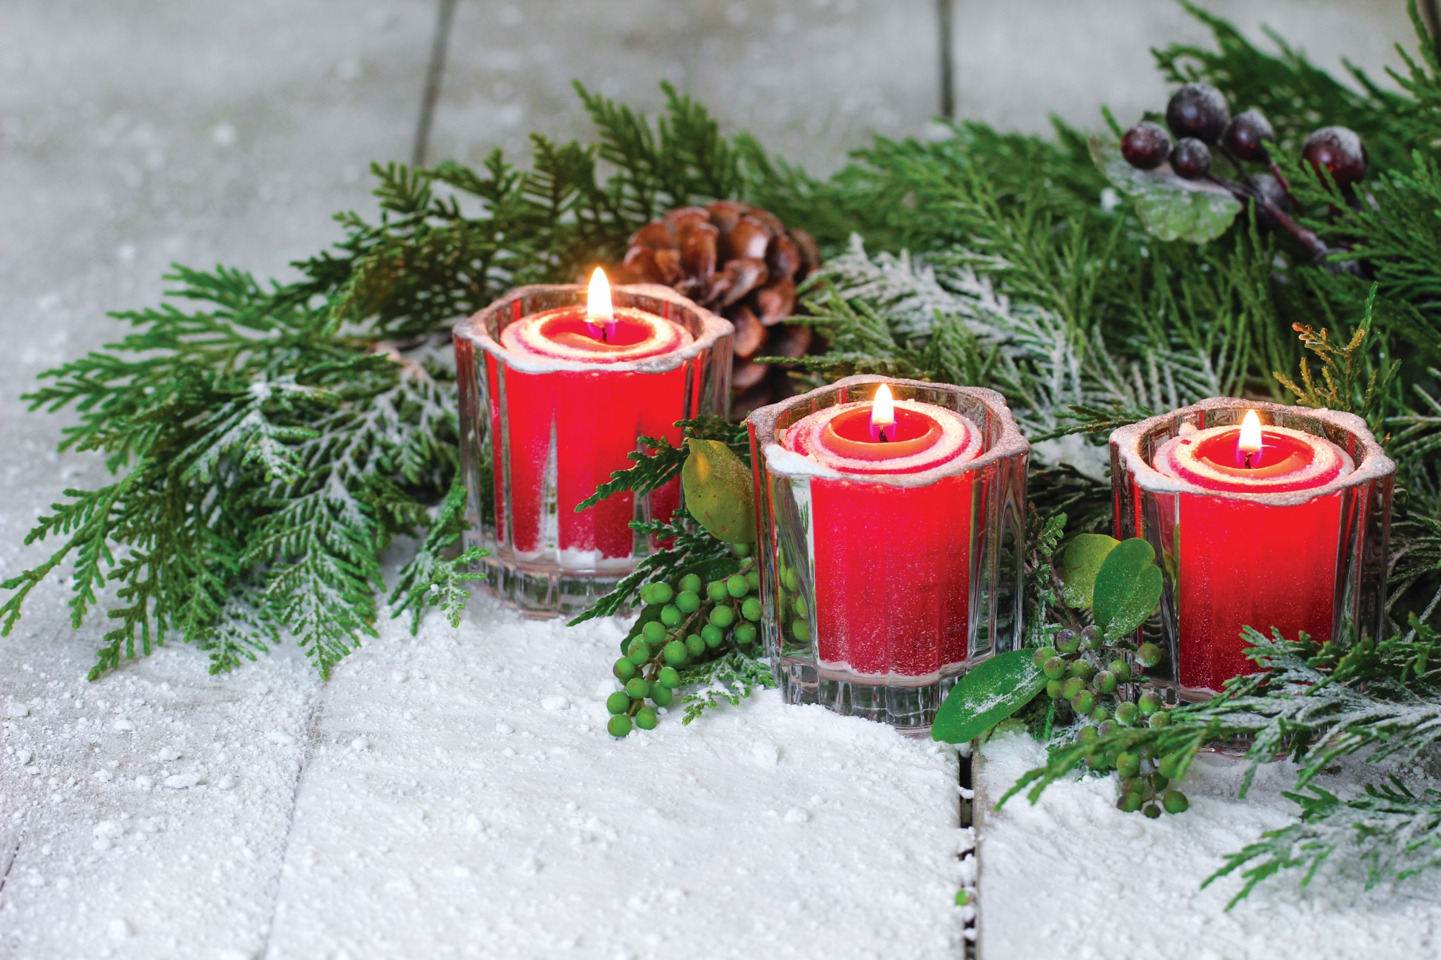
Christmas trees, candles and decorations
account for almost 2,000 fires each year.
There is also a rise in heating, cooking
and electrical fires.
Keep your candles in a safe holder and don’t leave them unattended.
Never put real candles on your Christmas tree.
Never leave your cooking equipment unattended.
If you’re using a turkey fryer, use it on flat ground and more than 10 feet from the house.
Follow instructions for all electrical and cooking equipment. Don’t use if damaged!
Source: earthsciences.typepad.com
Copyright ©2019 by SafeStart. All rights reserved. SafeStart is a registered trademark of Electrolab Limited.

Slide 9
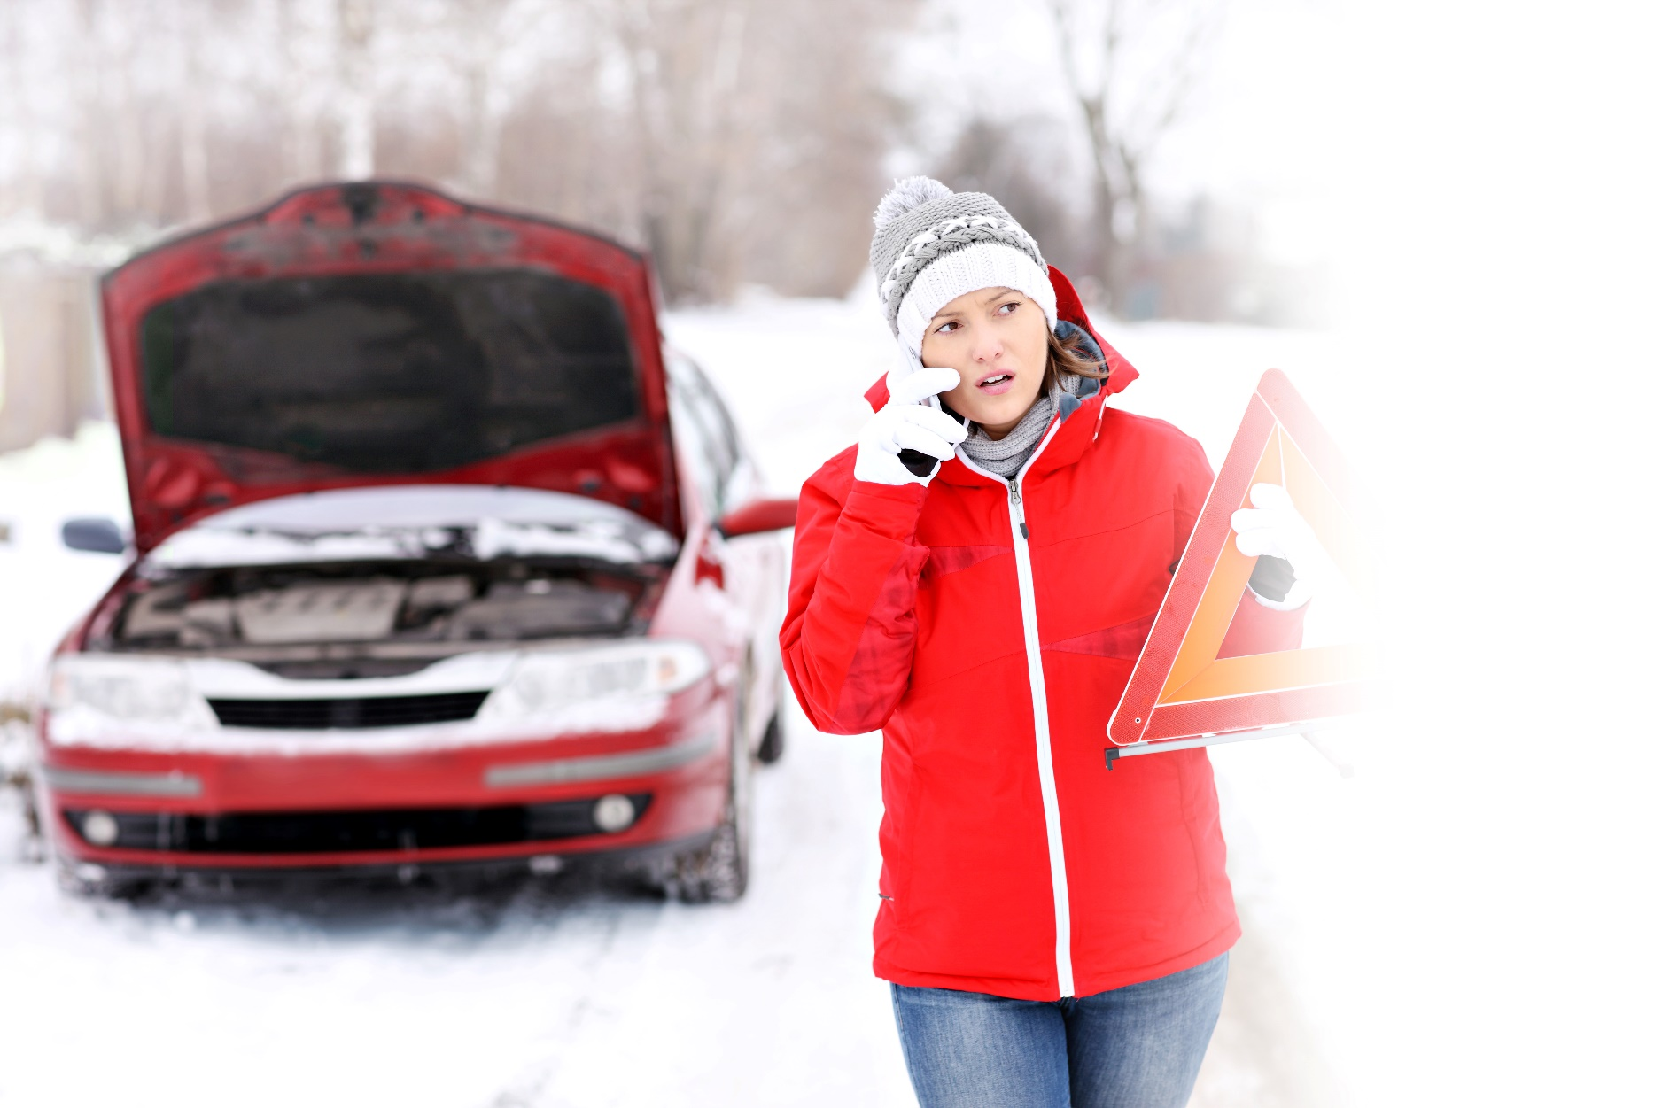
Car crashes are one of the most common injury and fatality causes during the holiday season.
More drivers on the road.
They are also stressed, rushed, and sometimes driving impaired.
Poor weather conditions or severe weather conditions.
Copyright ©2019 by SafeStart. All rights reserved. SafeStart is a registered trademark of Electrolab Limited.

Slide 10
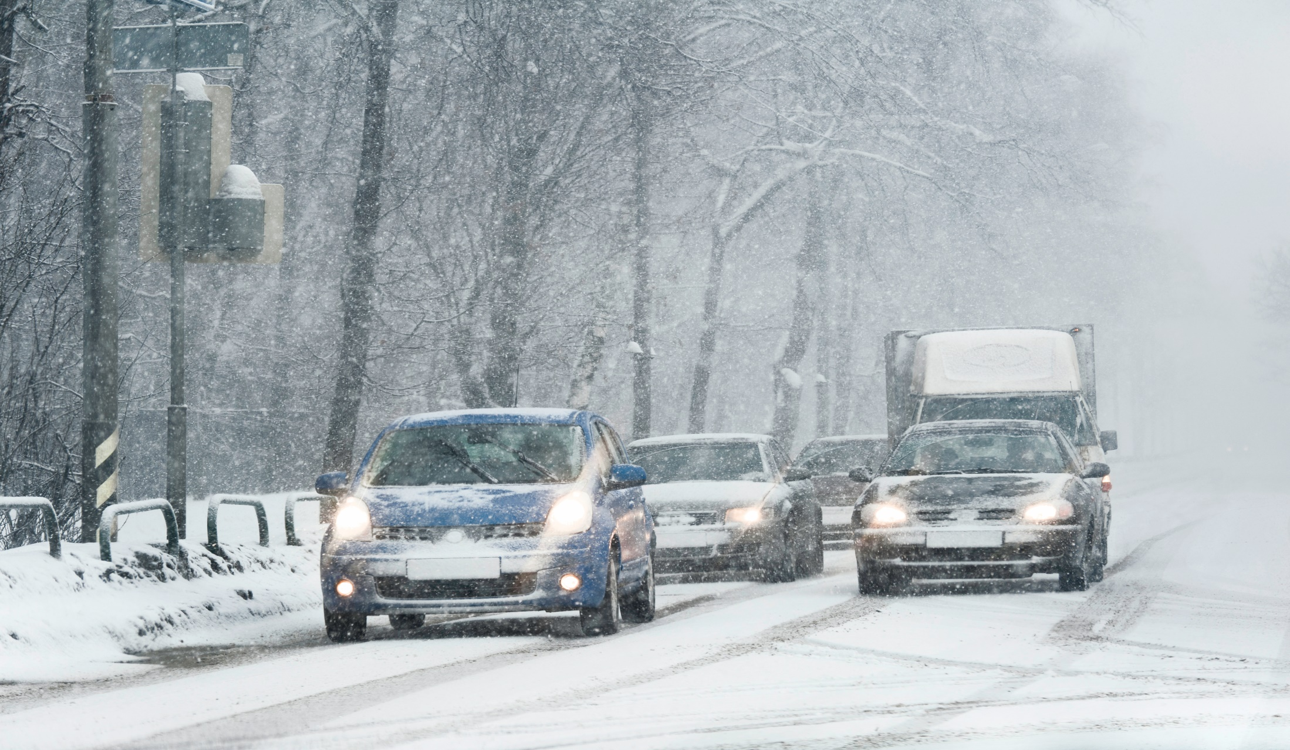
Pay extra attention to other drivers.
Do not drive unless it is completely necessary.
Avoid using cruise control on slippery roads or on roads you suspect might be slippery.
Ensure that you have a full tank, extra windshield washer fluid and a first aid kit in the car.
Bring a ‘survival kit’ that includes booster cables, warm clothes, a small shovel, a torch, a whistle, water and non-perishable foods.
Copyright ©2019 by SafeStart. All rights reserved. SafeStart is a registered trademark of Electrolab Limited.

Slide 11
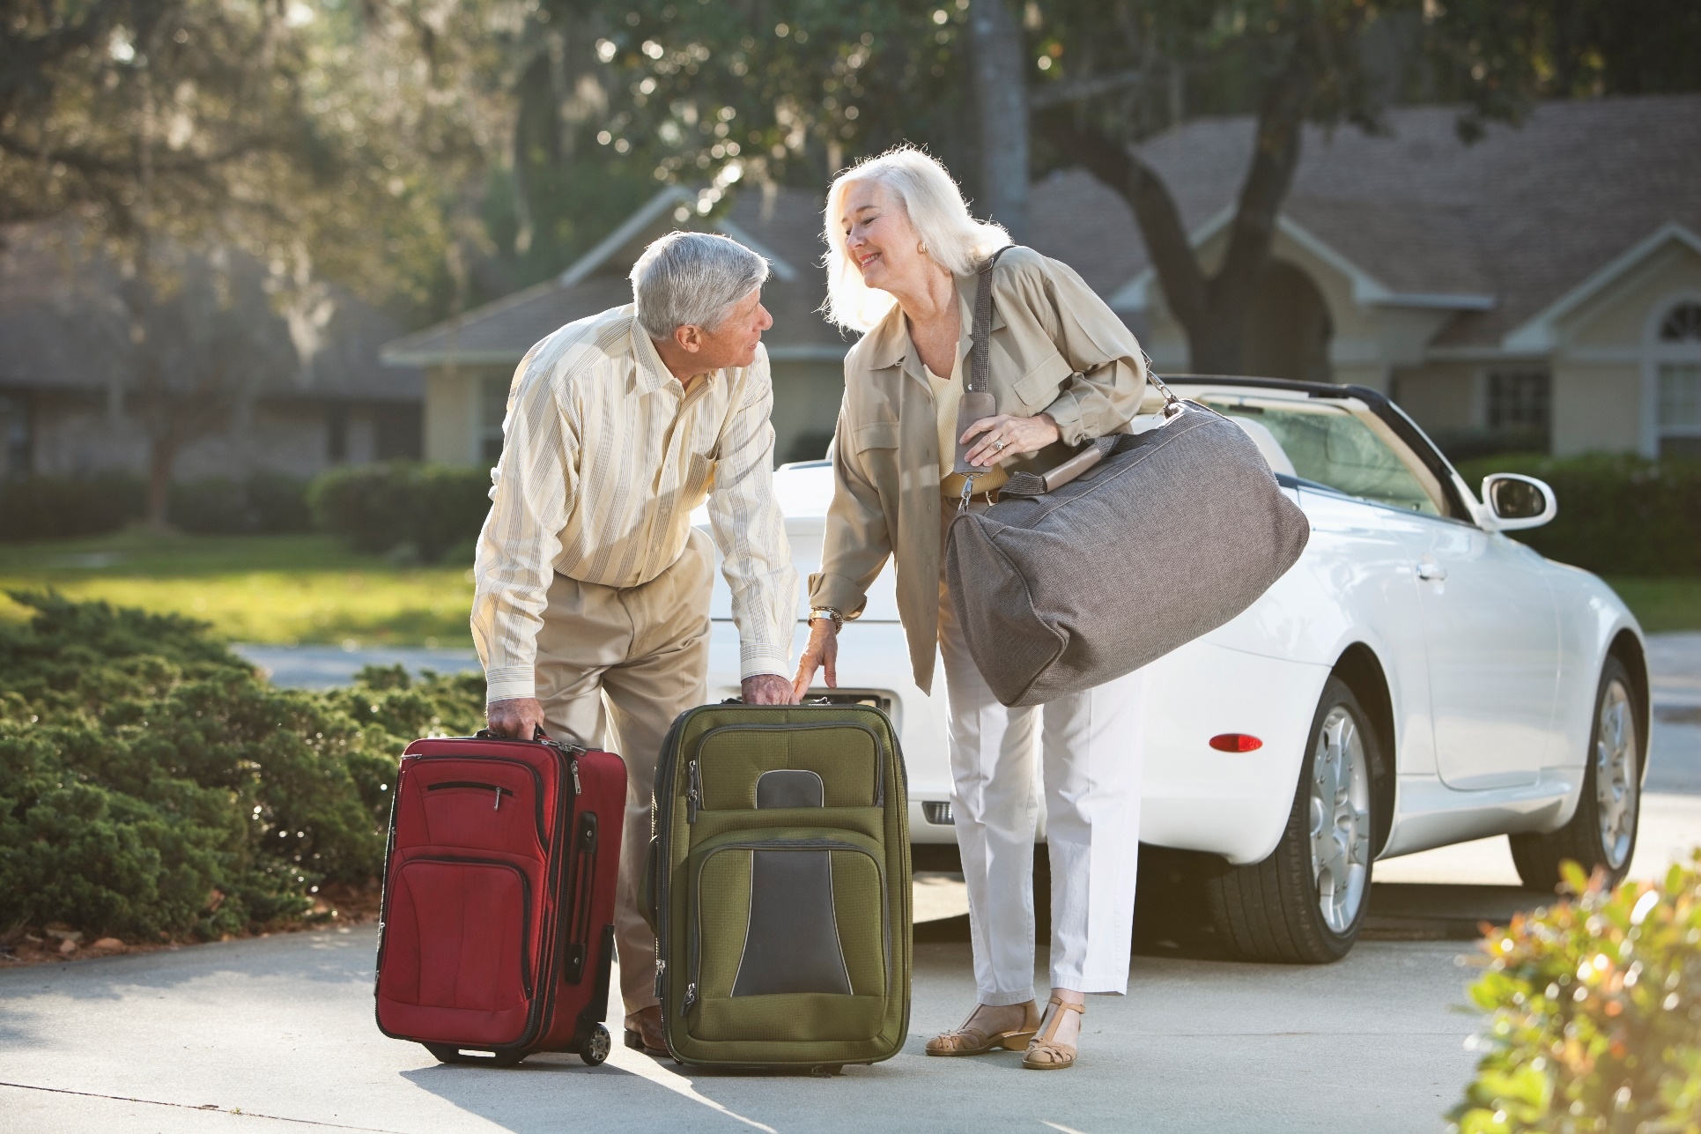
Tens of thousands of people require treatment each year because of injuries related to carrying luggage.
Use proper lifting techniques.
Choose luggage with wheels and handles.
Try to pack lightly, only taking things that are necessary.
Don’t rush. It’s better for your back to make a few more trips to the car than get hurt.
Source: orthoinfo.aaos.org
Copyright ©2019 by SafeStart. All rights reserved. SafeStart is a registered trademark of Electrolab Limited.

Slide 12
Wrap rage: the high levels of anger and frustration caused by the inability to open tricky packaging.
Thousands of people have to visit the emergency room each season because of packaging-related injuries.
Don’t let yourself become frustrated.
Do NOT use your teeth to open tricky packaging.
Don’t grab the first pointed or bladed thing you can find. Use an appropriate tool for the job.
Source: www.thestar.com
Copyright ©2019 by SafeStart. All rights reserved. SafeStart is a registered trademark of Electrolab Limited.

Slide 13
Food poisoning is rampant during the holiday season. Meat alone is responsible for over a million cases of food poisoning a year.
Wash your hands frequently and thoroughly when handling food.
Keep meat, poultry, seafood, and egg foods separated from other foods in the fridge.
Use separate cutting boards for raw
meat and cooked or ready-to-eat items.
Thanksgiving and Christmas leftovers
are safe for four days in the refrigerator.
Source: www.livestrong.com
Copyright ©2019 by SafeStart. All rights reserved. SafeStart is a registered trademark of Electrolab Limited.

Slide 14
Cooking-related injuries (cuts and burns especially) are common over the holiday season.
Think about your state of mind regularly.
Make sure your kitchen floor is clean and free of spills, pieces of food, and other tripping hazards.
Slow down or calm down before handling sharp or hot objects.
Copyright ©2019 by SafeStart. All rights reserved. SafeStart is a registered trademark of Electrolab Limited.

Slide 15
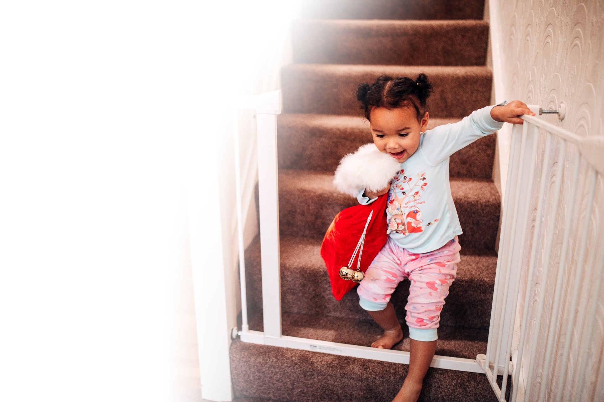
Visiting family members and friends might not be familiar with your house and your habits
(like the fact that you store Pine Sol® next to cooking oil).
Make sure you warn them of anything they
should know.
Provide visitors with a safe place to put their medicines and ensure that your own is not
easily accessible.
Provide guests with night lights or easy-to-
reach lamps.
Check your carbon monoxide alarms and
ensure they are functioning properly.
Copyright ©2019 by SafeStart. All rights reserved. SafeStart is a registered trademark of Electrolab Limited.

Slide 16
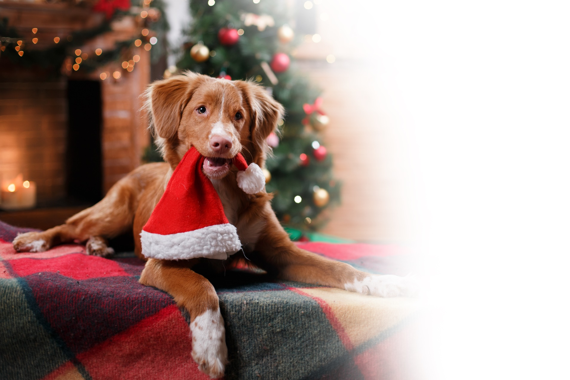
Every holiday season, there is a substantial increase in calls to Pet Poison Helpline.
Keep Christmas cacti and holiday bouquets containing lilies, holly or mistletoe away from pets.
Take the list of pet poisons with you and stick it on your fridge.
Avoid using tinsel (and ribbon, yarn and thread).
Keep liquid potpourri and essential oils out of your pets’ reach.
Keep snow globes out of reach. Some imported ones can contain antifreeze.
Source: Pet Poison Helpline
Copyright ©2019 by SafeStart. All rights reserved. SafeStart is a registered trademark of Electrolab Limited.

Slide 17
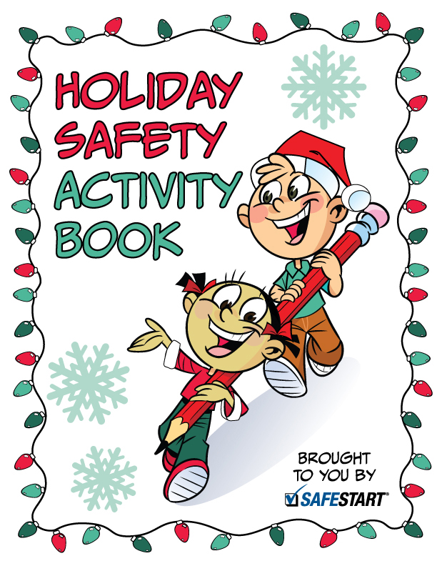
Share the activity booklet with your children.
Help them if they need it.
Copyright ©2019 by SafeStart. All rights reserved. SafeStart is a registered trademark of Electrolab Limited.

Slide 18
Share the brochure with your loved ones.
It contains more specific advice on each of the hazards we talked about today.
Copyright ©2019 by SafeStart. All rights reserved. SafeStart is a registered trademark of Electrolab Limited.

Slide 19
You might find some of this information pretty obvious.
BUT
It’s the season of rushing, frustration and fatigue.
These states of mind make you ignore, downplay or forget about hazards.
Injuries and fatalities increase despite people knowing the hazards.
SO
Review the brochure and keep the tips in mind.
It might be enough to keep your family out of the Emergency Room this holiday season.
Copyright ©2019 by SafeStart. All rights reserved. SafeStart is a registered trademark of Electrolab Limited.

Slide 20
Have a wonderful, safe holiday!
Copyright ©2019 by SafeStart. All rights reserved. SafeStart is a registered trademark of Electrolab Limited.

