Slide 1


Slide 2
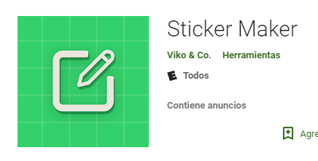
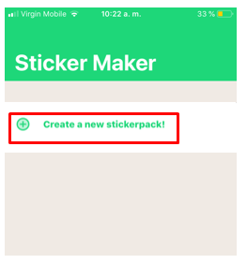
Step 1
Step 2
Download the Sticker Maker application.
Available in App Store and Play Store.
Login to create a sticker group

Slide 3
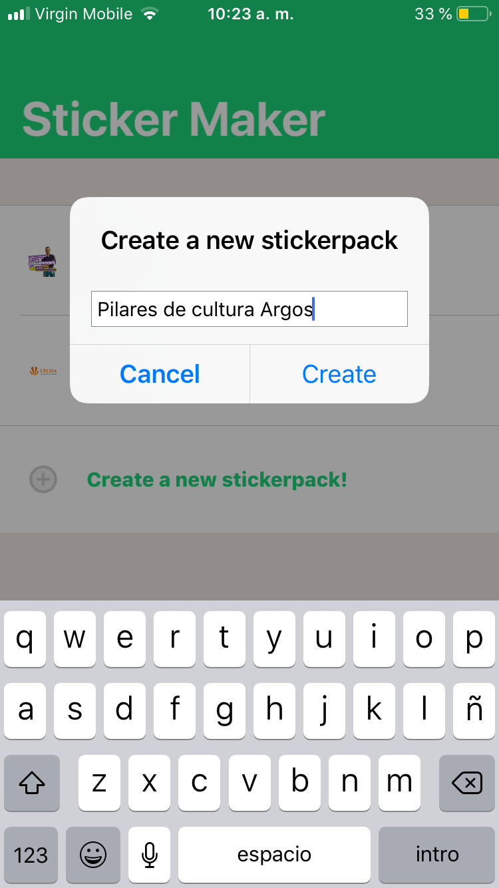
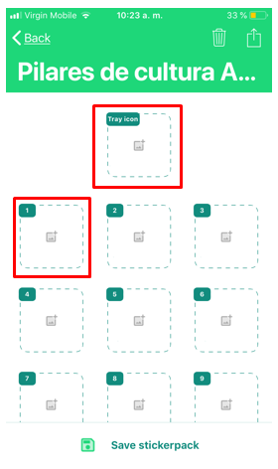
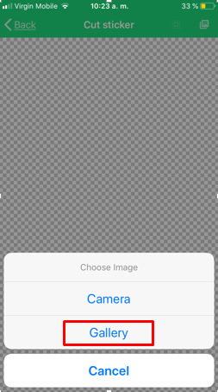
Step 3
Step 4
Assign a name to the new sticker group
Enter the group and click on the boxes to import the stickers.
You must choose an image from your gallery to identify the group and include at least 3 stickers to use them.

Slide 4

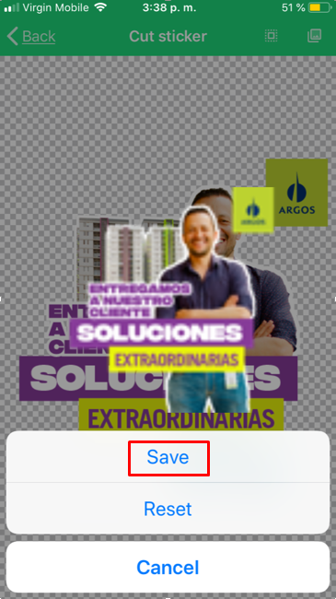
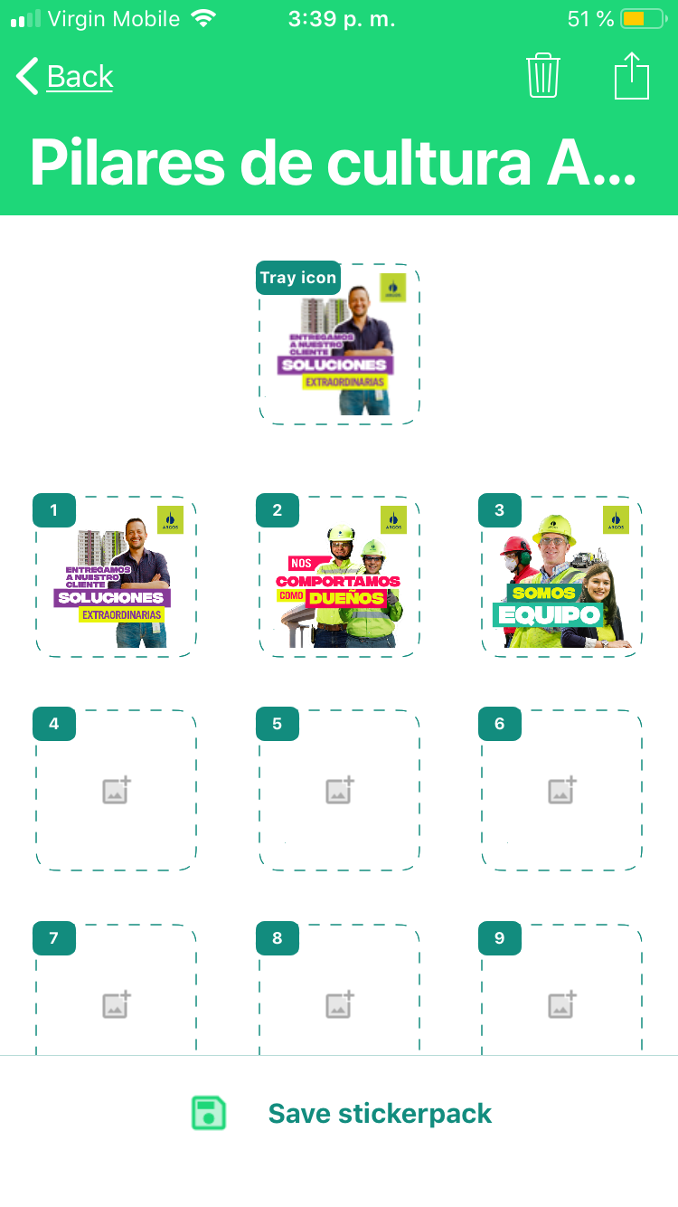
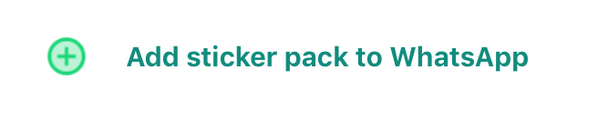
Step 5
Step 6
Once the image is selected, click on the penultimate box and then click on Save.
When you have selected the stickers, press Save stickerpack to save and Add sticker pack to open in WhatsApp.

Slide 5
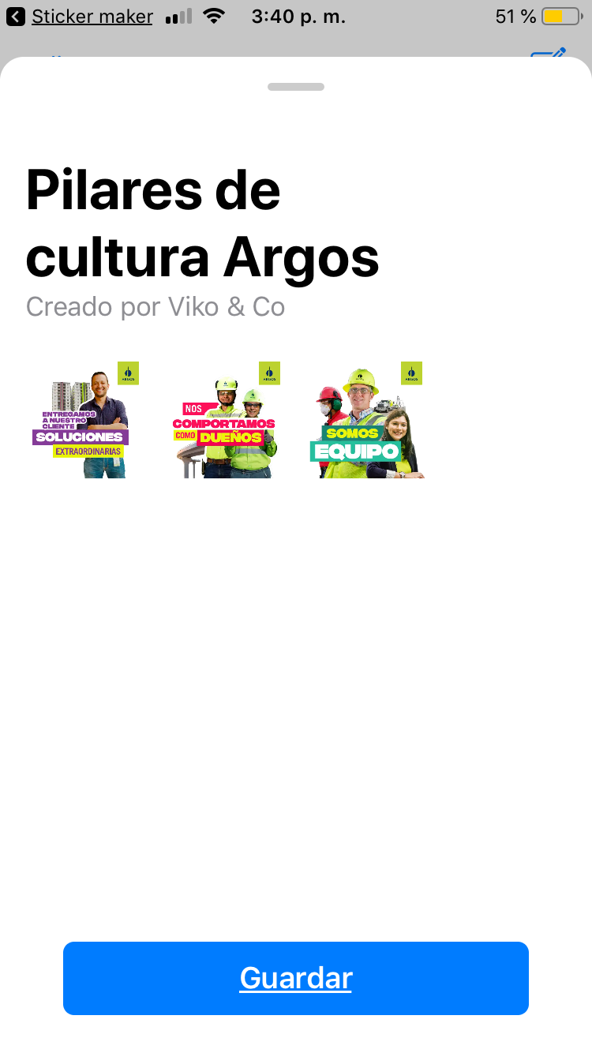
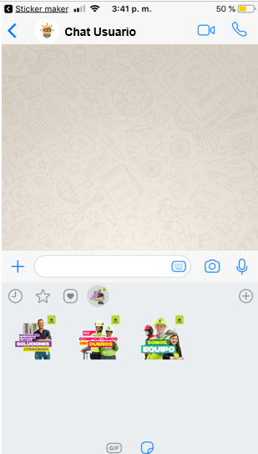
Step 7
Step 8
Then press Save
Select the Sticker you want to publish

