Slide 1
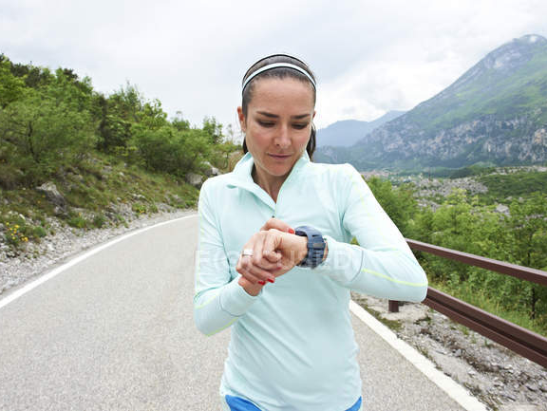
PERFORMANCE APPRAISAL CONVERSATION

Slide 2
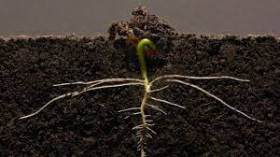
Continuos Performance Management
Two components:
OKRs (Objectives and Key Results)​
CFRs (Conversation, Feedback and Recognition)​

Slide 3

Models
C
F
R
Conversation
Planned
No planned
Feedback
Recognition
No planned
• Reflection and definition OKR
Advancement OKR
Performance Appraisal
Development
360
No planned
Cultural adjustment
January 31
2022
Set up 2021

Slide 4
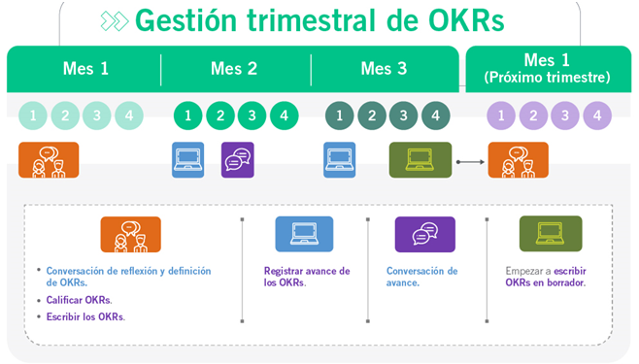
Jan
Feb
Mar
Apr
May
Jun
Jul
Ago
Sep
Oct
Nov
Dic
Performance Appraisal Conversation
Development conversation
Feedback and Recognition

Slide 5
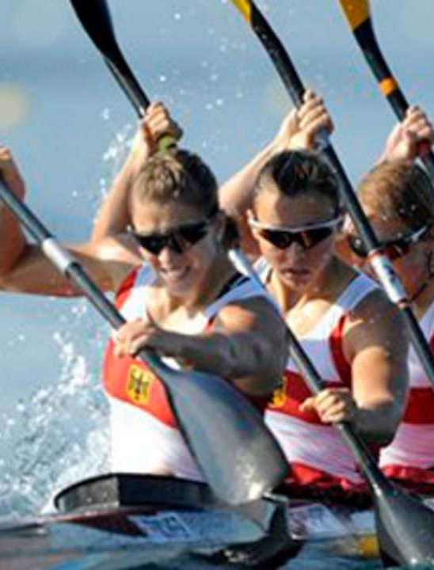
Performance Appraisal Conversation
The objective of the Annual Performance Appraisal Conversation is to assess each person’s individual contribution to the company’s objectives and key results and, in turn, to evaluate behaviors during the performance cycle that allow to show the culture of Argos..
“Conversation as an opportunity for feedback”

Slide 6

Coversing as a habit
Natural
Practical
Value ¿For what?
Signal + routine + reward + habit

Slide 7
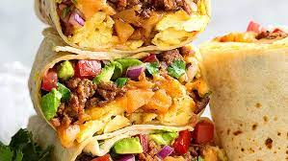
Feedback structure
Feedback is built on layers, one ingredient at a time.
To serve while hot.
Observed behavior
Performance
effect
Perceptions
Conclusions
Notes:
Elogio: aprobación de un hecho para que la persona lo siga haciendo o lo haga más.
Desaprobación: información de un hemos para que la persona lo haga menos o lo deje de hacer. Es para redireccionar un comportamiento futuro. Describa alternativas de cómo se pudo abordar la situación (si fuera necesario).

Slide 8
Feedback structure
Observed behavior
Performance
effect
Perceptions
Conclusions
Describes when and where did the behavior occurred, who was there and what happened. It must be specific
Describes without judgment, results you observe were achieved by the person or the actions and activities they used to reach them.
Examine perceptions.
Mention your perception about the situation, whether it is of approval or disapproval, and how did that make you feel.
Agree on the steps to follow:
Recommendations
Possible consequences
Resources
Help from the person giving feedback or from other people
Follow-up
Notes:
Elogio: aprobación de un hecho para que la persona lo siga haciendo o lo haga más.
Desaprobación: información de un hemos para que la persona lo haga menos o lo deje de hacer. Es para redireccionar un comportamiento futuro. Describa alternativas de cómo se pudo abordar la situación (si fuera necesario).

Slide 9
Components
Performance Appraisal Conversation
1.Objectives and Key Results Assessment, for which it must be considered each OKR cycle’s performance during the whole year.
2. Conversation and Appraisal of Cultural Adjustment, for which it must be considered each pillar of culture, their description, and behaviors. Keep in mind that you’re going to evaluate the pillar, the information associated with description and behaviors of each pillar, they are elements to enhance the conversation

Slide 10
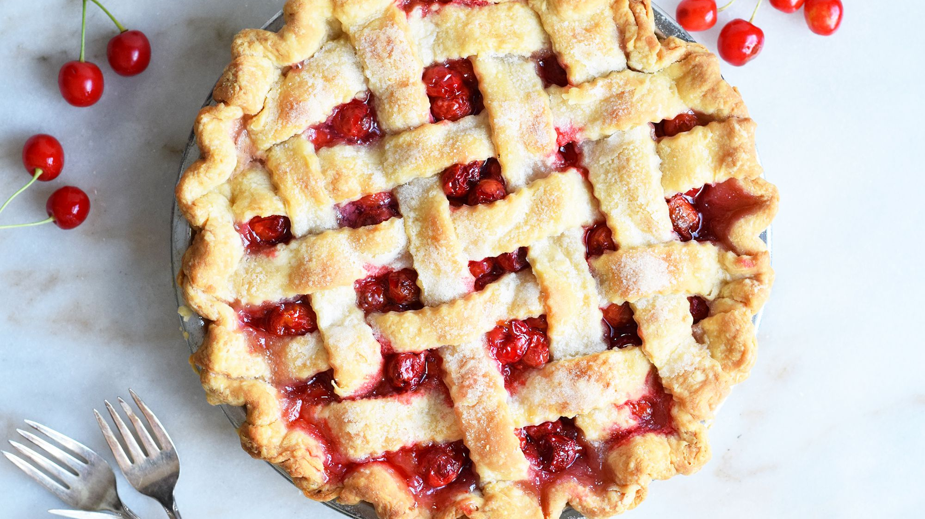
Final assessment of each component ​
In the question section for the leader, questions 4 and 5. The purpose of both the Final assessment of the culture component and the Final assessment of OKRs component, is to globally evaluate each person’s performance in each component.
This doesn’t mean that there is a mathematical average.
Each leader must give their perception in a global fashion for each component, taking into account the person’s performance during the whole year.

Slide 11


Slide 12


General reflections
¿When does it happen?
January of the following year
In order to integrally assess people’s performance, considering two main components:
Objectives and Key Results
Cultural Adjustment (behaviors that tell us “How we do things in Argos”)
¿What does it happen for?

Slide 13

General reflections
¿What do I need to prepare?
Leader and collaborator:
Information about the performance of the collaborator during the year, related to OKRs and Cultural Adjustment.
Records at BetterWorks regarding conversations that took place during the year are valuable when building a visual of annual performance for each person.

Slide 14

General reflections
¿How do I it?
By entering into the conversation that will appear in the Conversations module in BW, keeping in mind the deadline to develop it.
The conversation is created by the administrator of BetterWorks and appears loaded onto the Conversations module of every person that make up BetterWorks.

Slide 15

General reflections
¿What benefits do I get?
As a leader, it’s a valuable opportunity to have a visual of each person’s annual performance. It allows to identify opportunities of improvement and also strengths that must be capitalized as learnings.
As a collaborator, to engage in a conversation about individual contribution to objectives and outlined results, as well as a clear measurement of individual behaviors, and how are they supporting or not the organization’s culture. It’s a valuable chance to identify strengths and learning opportunities, to enrich the individual’s development plan and to reflect on the generated learnings.

Slide 16

General reflections
Doing a conversation without having a visual of the year, and instead focusing only on the last trimester or in people’s behaviors and contributions that that people didn’t sustain during the year
Not making it synchronously (everyone meeting up at the same time, whether it be virtual or in person), assuming that all topics were already addressed during the year.
Looking for an empathy that will not generate grow and development, people abstain of sharing their perceptions and points of view, avoiding to hurt others or to encourage conflicts
Common mistakes

Slide 17
Thanks

