Slide 1

ZBB Budget 2023
Services, Fees, Various & Maintenance

Slide 2
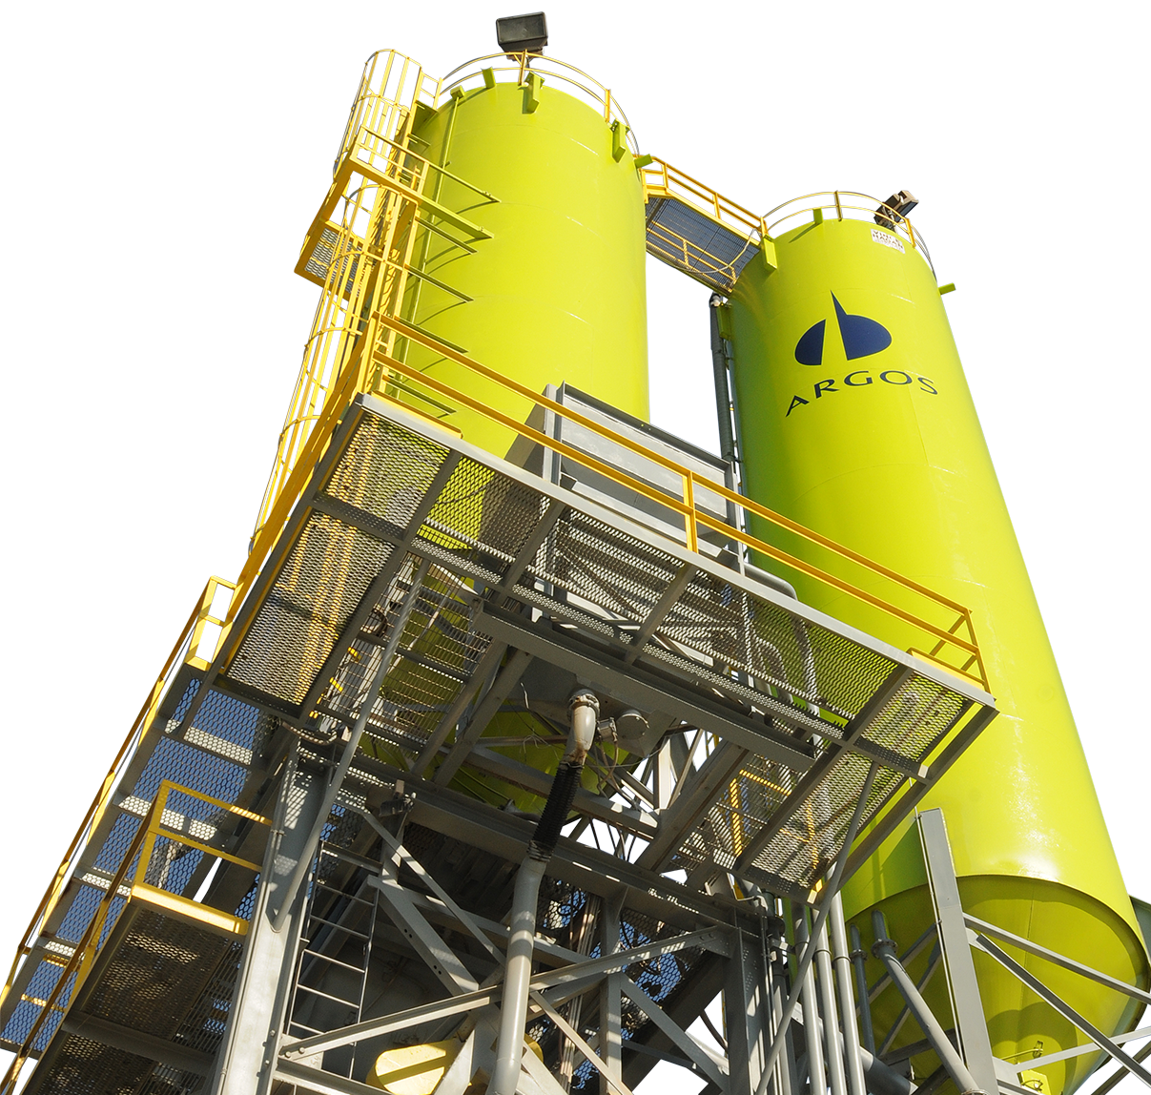
Agenda

Slide 3
Agenda
ZBB Context
ZBB Accounts 2022
BPC Access
Maintenance Package
  Maintenance Budget Template
  Flat File Load
Services, Fees & Various
  Flat File Load
Non ZBB Accounts
  Flat File Load

Slide 4


1. ZBB Context
What is ZBB – Zero Based Budgeting?
It is a budgeting method that has recently been implemented in various organizations around the world to efficiently improve the resource allocation within the company.
It is based on building the company's budget based clearly on the needs of its businesses and areas, making resources available, when and where they are truly needed, and avoiding the creation of budget "bags" that affect the efficiency of the company.
With its implementation it is sought:
Clarity and transparency in the distribution of resources.
Accountability in the budgeting process.
Rationality in resource management.
Agility in decision-making processes.
Through a Collaborative Effort

Slide 5






1. Generalidades ZBB
What is the purpose of ZBB in 2023 Budget?
Obtain greater detail of the budegt in each of the accounts o this methodology in order to identify from the planning how the execution Will be.
Ex.:
ACCOUNT | ACCOUNT CATEGORY | EXPLANATION
10005201010235 - EXPENSES ADMIN - FEES TECHNICAL ASSISTAN | 5201010235_01 - Management consulting services | Fees for improving the budget deviation tool
What are the accounts included in ZBB?
Maintenance
Services
Fees
Various

Slide 6

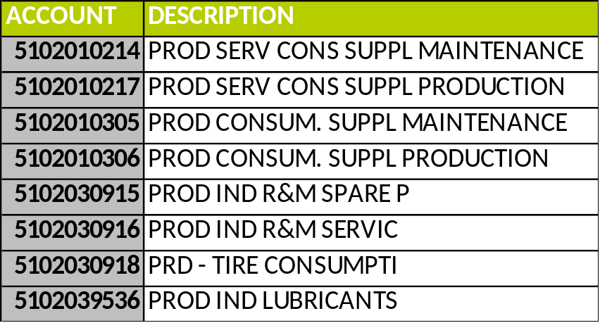

2. Accounts Included in ZBB 2023
Maintenance
This applies to any cost center that requires the use of any of these accounts, both, those of the main production processes (clinkerization, cement grinding, extraction), as well as those of support areas in case they require maintenance (quality, infrastructure, etc. )

Slide 7

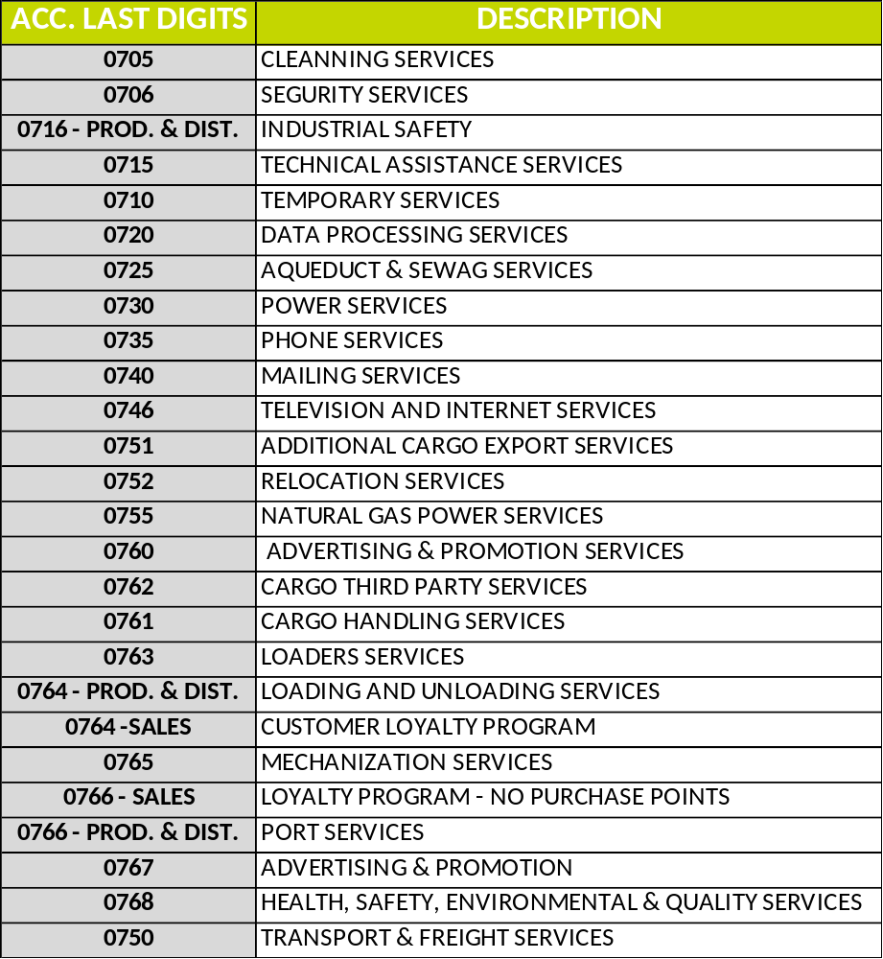

2. Accounts Included in ZBB 2023
Services
Applies to all accounts of:
Production (Starts with 510203)
Distribution (Begin with 510112)
Administration (Begin with 520101)
Sales (Starts with 520201)

Slide 8

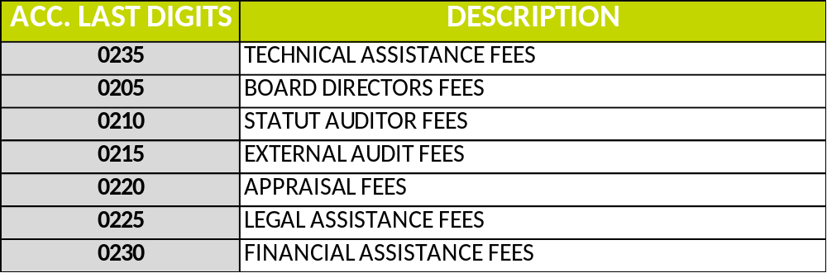

2. Accounts Included in ZBB 2023
Fees
Applies to all accounts of:
Production (Starts with 510203)
Distribution (Begin with 510112)
Administration (Begin with 520101)
Sales (Starts with 520201)

Slide 9
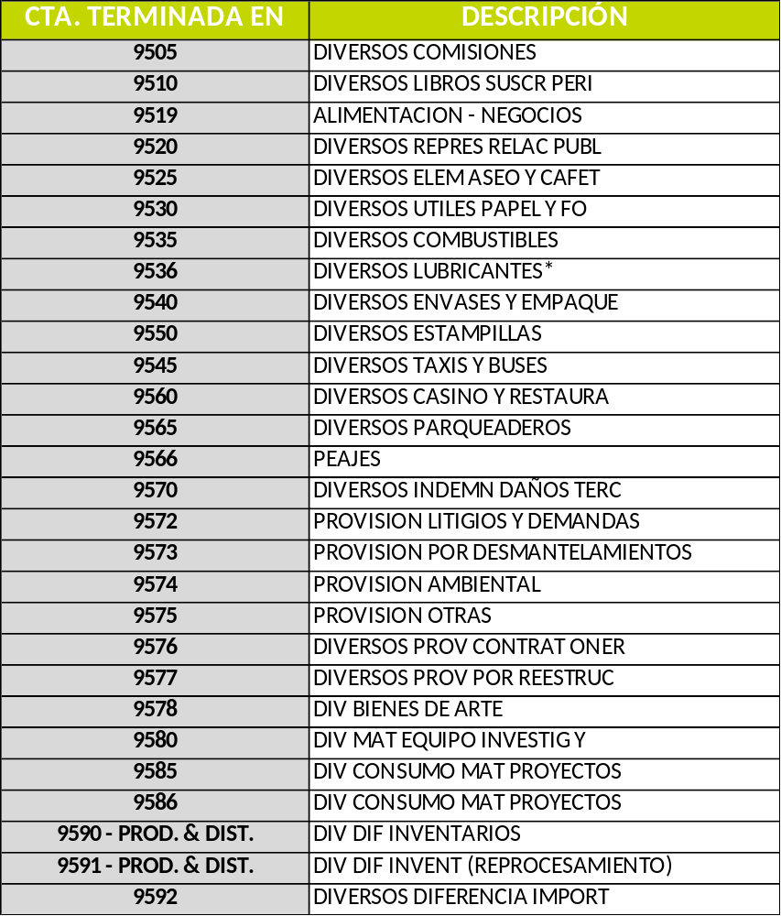

2. Cuentas incluidas en ZBB 2023
Various
Applies to all accounts of:
Production (Starts with 510203)
Distribution (Begin with 510112)
Administration (Begin with 520101)
Sales (Starts with 520201)
*Except for Production Lubricants, which is an account of the Maintenance package if it begins with 510203

Slide 10

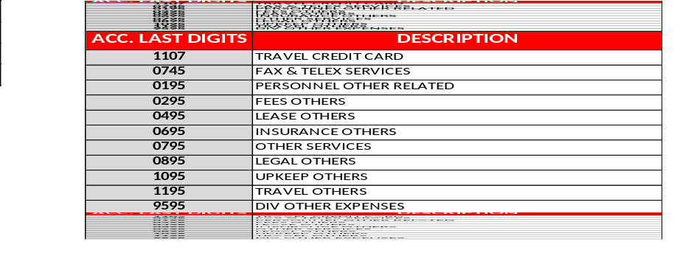


3. Excluded Accounts
Excluded Accounts
Applies to all accounts of:
Production (Starts with 510203)
Distribution (Begin with 510112)
Administration (Begin with 520101)
Sales (Starts with 520201)
File with excluded accounts.

Slide 11


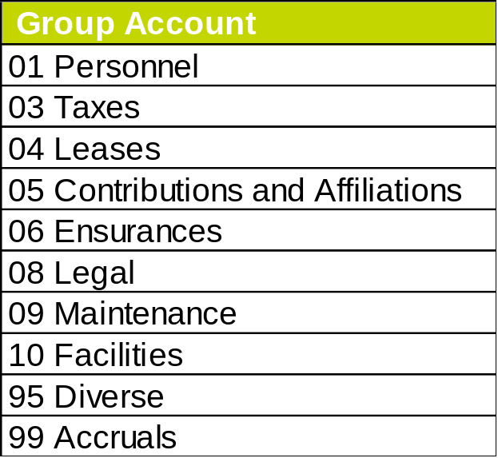
4. Non ZBB Accounts
The following group of expenses are out of the ZBB scope for 2023

Slide 12


Any questions?
If you have any questions, you can contact us in the Teams channel that we have created exclusively for budget just by accessing the following link:
2023 Budget Channel on Teams
Thank you!

