Slide 1

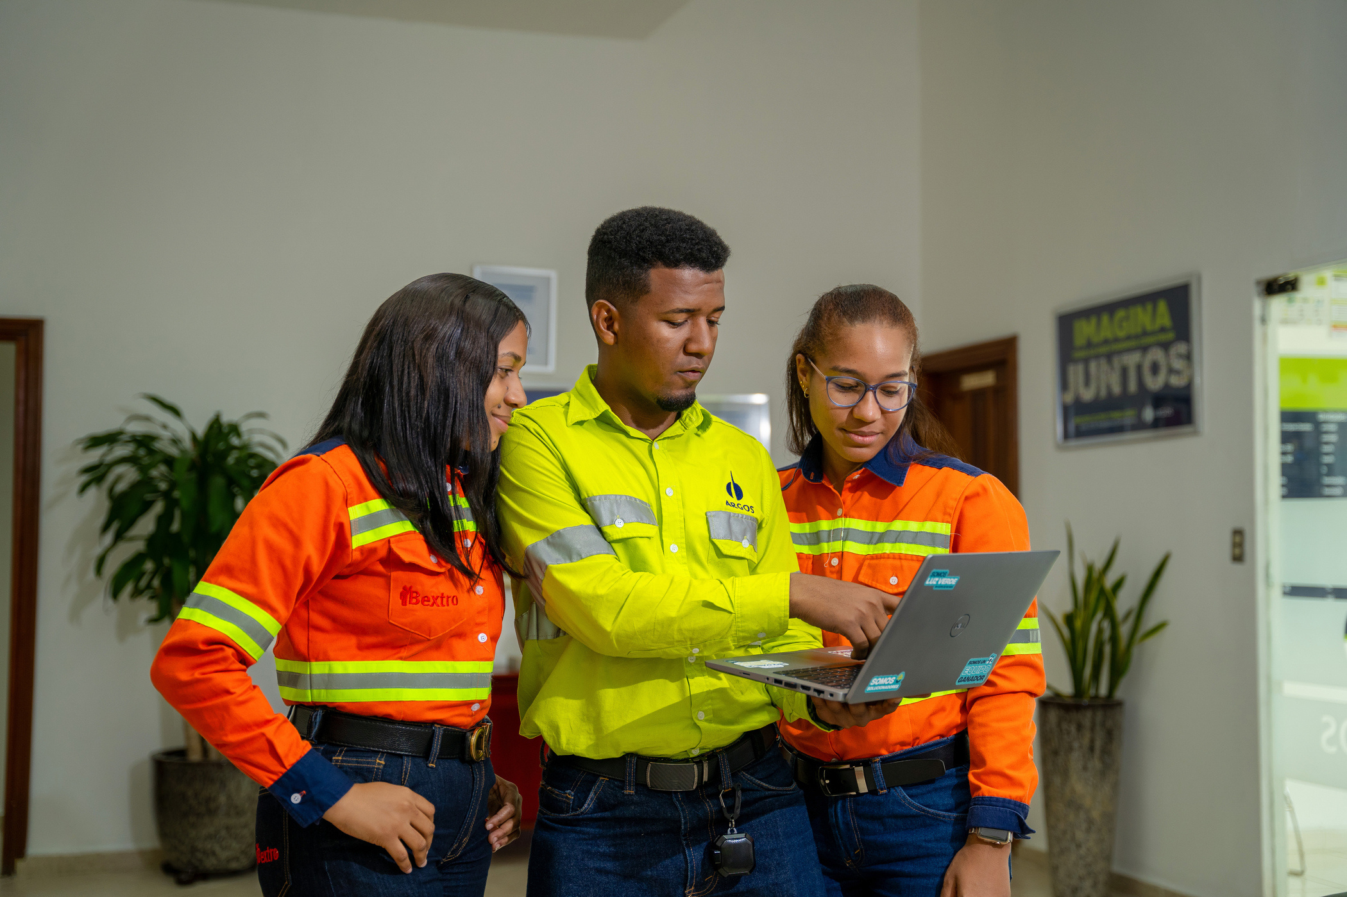

CARIBBEAN REGIONAL MEDIA AND CHANNELS

Slide 2

MAIN FINDINGS CARIBBEAN
Principales hallazgos caribe
GENERAL REFLECTIONS:
  Videos are the preferred format, text is the least chosen.
  Operation leaders are one of the main communication channels.
  Digital screens less valued
  WhattsApp as most prominent channel (- in Puerto Rico).
ConsideraTIONS:
  Do not overwhelm.
  Leaders' spaces with local allies.
  Short and clear content.
  French Guayane / Need to connect and communicate.
  Digital screens go out. Each territory validates its functionality and budgets for 2026 if necessary.
REGIONAL MEDIA AND CHANNELS:
  Webinar: Entertaining content and stories of trajectory. As well as strategic issues and success stories. Positive feedback from the panelists.
  Regional Newsletter by Gary de la Rosa: Overall, it was very positive perception.
  In general, it is very well rated.
formats:
  Audiovisual (all).
  Conversations (all).
  Suriname reading and creative images (language - local translator).
Notes:
Validar con Rachel el tema de la traducción local. Percepción y otras alternativas.

Slide 3

CARIBBEAN MEDIA STRATEGY
PUBLIC | MEDIA / CHANNEL | OBJECTIVE | FORMAT | TONE | FREQUENCY | KPI | RESPONSIBLE
Administratives Operatives | Caribbean Conversation | Discuss relevant issues concerning the Caribbean Region. | Conversation / virtual | Fresh and close to connect employees with other teams and territories in the region. | Annually | • Number of attendees • Satisfaction surveys | Communications
Administratives | E-mail Communications Argos Caribbean | Communicate in a timely manner relevant company or regional news and milestones. | Mail, screens, (local management) We are Caribbean section or WP allied GH / Ecard, video or audio | Corporate and interactive | As required | Open and click-through rates | Communications
Administratives Operatives | Caribbean Regional Newsletter | Position Gary as a spokesperson for the milestones and relevant events of the region. | • Email Gary • WhatsApp allies GH • Digital Screens (local management) | Corporative and close | Half-yearly | • Viewing rate • Perception surveys | Communications
Notes:
Enfoque en fortalecer los medios directos con líderes y aliados locales

Slide 4
PUBLIC | MEDIA / CHANNEL | OBJECTIVE | FORMAT | TONE | FREQUENCY | KPI | RESPONSIBLE
Leaders | Caribbean WP leaders distribution list / Green Light Conversations | Deliver tools to leaders aligned with their role and the business strategy. | Conversations with Green Light / Video | Close and interview type | Quarterly | Viewing rate | Communications
Leaders | Caribbean leaders distribution list / Tools | Deliver tools to leaders aligned with their role and the business strategy. | Podcast, video, audio, among others | Dynamic, corporate and close | Fortnightly | Viewing rate WhatsApp surveys | Communications
Leaders | Caribbean leaders distribution list / News | Informing leaders of relevant company events. | Video, infographics, ecards, audios, among others. | Dynamic, corporate and close | On demand | Viewing rate | Communications
Human Resources Allies | Caribbean allies WhattsApp group | Timely reporting of regional and corporate news and campaigns. | Video, infographics, ecards, audios, among others. | Dynamic, corporate and close | On demand | Viewing rate | Communications

Slide 5
TIMELINE CARIBBEAN MEDIA
Webinar
Caribbean
Newsletter
Caribbean Regional #2
May
June
July
August
September
October
November
December
Conversations
Green Light #1
May 26th
Newsletter
Caribbean Regional #1
June 16th
Conversations
Green Light #2
Conversations
Green Light
#3

Slide 6









FINDINGS BY TERRITORY
puerto rico
SURINAME
  Prioritize entertaining content and stories of trajectory.
  WhatsApp is not such a priority channel.
  Videos are the preferred format, text is the least chosen.
  Local leaders of the main communication channels.
  Local newsletter moderately valued.
  It is recommended that more audiovisual formats be included.
  The Caribbean Conversatory was well received.
  It is suggested that a local translator be hired.
  Leaders can play a key role as a local communication channel.
  It is important to explore more accessible formats, such as local reporters.
dominican republic
ANTILLES
  Success stories and strategic themes.
  The audiovisual format is the most chosen.
  More than 81 % consider the regional newsletter useful.
  Digital screens are the least valued in terms of impact.
  Leaders are key in the humanization of messages.
  The survey had a positive participation.
  WhatsApp is the medium with the highest acceptance.
  The Caribbean Conversatory is well received as it prioritizes strategic issues and success stories.
  It is necessary to create spaces for the projection and participation of collaborators.
  The regional newsletter is well accepted.
  They prefer to receive content in audiovisual format.
  The local and regional mailboxes are not so highly valued.

Slide 7
LOCAL STRATEGY PUERTO RICO
PUBLIC | MEDIA /CHANNEL | OBJECTIVE | FORMAT | TONE | FREQUENCY | KPI | RESPONSIBLE
Administratives Operatives | To Date Newsletter | Keep employees updated on news and milestones related to operations. | Local mailbox Physical billboards (local management) | Corporate and close | Bimonthly | Open and click-through rates Viewing rate | Communications Human Resources of Puerto Rico
Administratives Operatives | Animated video To Date newsletter | Keep employees updated on news and operational milestones. | WP mailing lists Digital billboards (local management) Direct spatial projection | Close and fresh. | Bimonthly | Number of deliveries Programming | Communications
Administratives Operatives | Project and campaign communications. | Mobilize pertinent regional and local initiatives and campaigns. | Community mailbox Digital billboards (local management) WP mailing list | Corporate and close | On demand | Sending rate vs. views | Communications

Slide 8
LOCAL strategy dominican republic
PUBLIC | MEDIA / CHANNEL | OBJECTIVE | FORMAT | TONE | FREQUENCY | KPI | RESPONSIBLE
Administratives Operatives | To Date Newsletter | Keep employees updated on news and milestones related to operations. | Local mailbox Physical billboards (local management) | Corporate and close | Bimonthly | Open and click-through rates Viewing rate | Communications Human Resources of Dominican Republic
Administratives Operatives | Animated video To Date newsletter | Keep employees updated on news and operational milestones. | WP mailing lists Digital billboards (local management) Direct spatial projection | Close and fresh. | Bimonthly | Number of deliveries Programming | Communications
Administratives Operatives | Project and campaign communications. | Mobilize pertinent regional and local initiatives and campaigns. | Community mailbox Digital billboards (local management) WP mailing list | Corporate and close | On demand | Sending rate vs. views | Communications

Slide 9
LOCAl strategy SURINAMe
PUBLIC | MEDIA / CHANNEL | OBJECTIVE | FORMAT | TONE | FREQUENCY | KPI | RESPONSIBLE
Administratives Operatives | To Date Newsletter | Keep employees updated on news and milestones related to operations. | Local mailbox Physical billboards (local management) | Corporate and close | Bimonthly | Open and click-through rates Viewing rate | Communications Human Resources of Suriname
Administratives Operatives | Animated video To Date newsletter | Keep employees updated on news and operational milestones. | WP mailing lists Digital billboards (local management) Direct spatial projection | Close and fresh. | Bimonthly | Number of deliveries Programming | Communications
Administratives Operatives | Project and campaign communications. | Mobilize pertinent regional and local initiatives and campaigns. | Community mailbox Digital billboards (local management) WP mailing list | Corporate and close | On demand | Sending rate vs. views | Communications

Slide 10
LOCAL STRATEGY antilles
PUBLIC | MEDIA / CHANNEL | OBJECTIVE | FORMAT | TONE | FREQUENCY | KPI | RESPONSIBLE
Administratives Operatives | To Date Newsletter | Keep employees updated on news and milestones related to operations. | Local mailbox Physical billboards (local management) | Corporate and close | Bimonthly | Open and click-through rates Viewing rate | Communications Human Resources of Antilles
Administratives Operatives | Animated video To Date newsletter | Keep employees updated on news and operational milestones. | WP mailing lists Digital billboards (local management) Direct spatial projection | Close and fresh. | Bimonthly | Number of deliveries Programming | Communications
Administratives Operatives | Project and campaign communications. | Mobilize pertinent regional and local initiatives and campaigns. | Community mailbox Digital billboards (local management) WP mailing list | Corporate and close | On demand | Sending rate vs. views | Communications

Slide 11
CARIBBEAN MEDIA TIMELINE
Media matrix socialization
May
June
July
August
September
October
November
December
Media matrix campaign
To Date
To Date
To Date
To Date

Slide 12
TIMELINE to date - caribbean
FIRST EDITION
JUNE
JULY
Week 1
Week 2
Week 3
Week 4
Week 1
Week 2
Week 3
Week 4
Receiving of
information
Receiving of
information
Structuring
of content
Desing
Design modifications
Sending the
newsletter
1st review
Review by
Com. Caribbean
2nd review
Review by
Com. Caribbean
4th review
Final local
review
Sending animation
2rd review
Local review
3rd review
Local review
Production of the
animation in
design
Structure
script for
animation

Slide 13
TIMELINE to date - caribbean
SECOND EDITION
AUGUST
SEPTEMBER
Week 1
Week 2
Week 3
Week 4
Week 1
Week 2
Week 3
Week 4
Receiving of
information
Receiving of
information
Structuring
of content
Desing
Design modifications
Sending the
newsletter
1st review
Review by
Com. Caribbean
2nd review
Review by
Com. Caribbean
4th review
Final local
review
Sending animation
2rd review
Local review
3rd review
Local review
Production of the
animation in
design
Structure
script for
animation

Slide 14
TIMELINE to date - caribbean
THIRD EDITION
OCTOBER
NOVEMBER
Week 1
Week 2
Week 3
Week 4
Week 1
Week 2
Week 3
Week 4
Receiving of
information
Receiving of
information
Structuring
of content
Desing
Design modifications
Sending the
newsletter
1st review
Review by
Com. Caribbean
2nd review
Review by
Com. Caribbean
4th review
Final local
review
Sending animation
2rd review
Local review
3rd review
Local review
Production of the
animation in
design
Structure
script for
animation

Slide 15
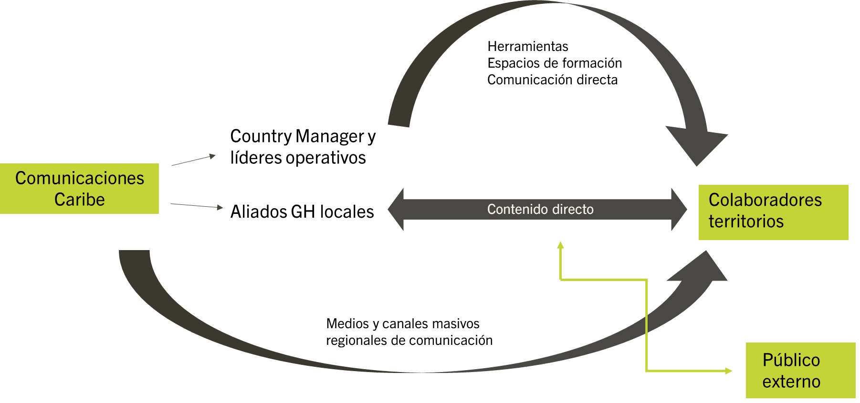
INTERNAL COMMUNICATION SCHEME
Tools
Training spaces
Direct communication
Country Manager and operational leaders
Caribbean
Communications
Local HR allies
Employees
territories
Direct content
Regional mass media and communication channels
External
public

