Slide 1


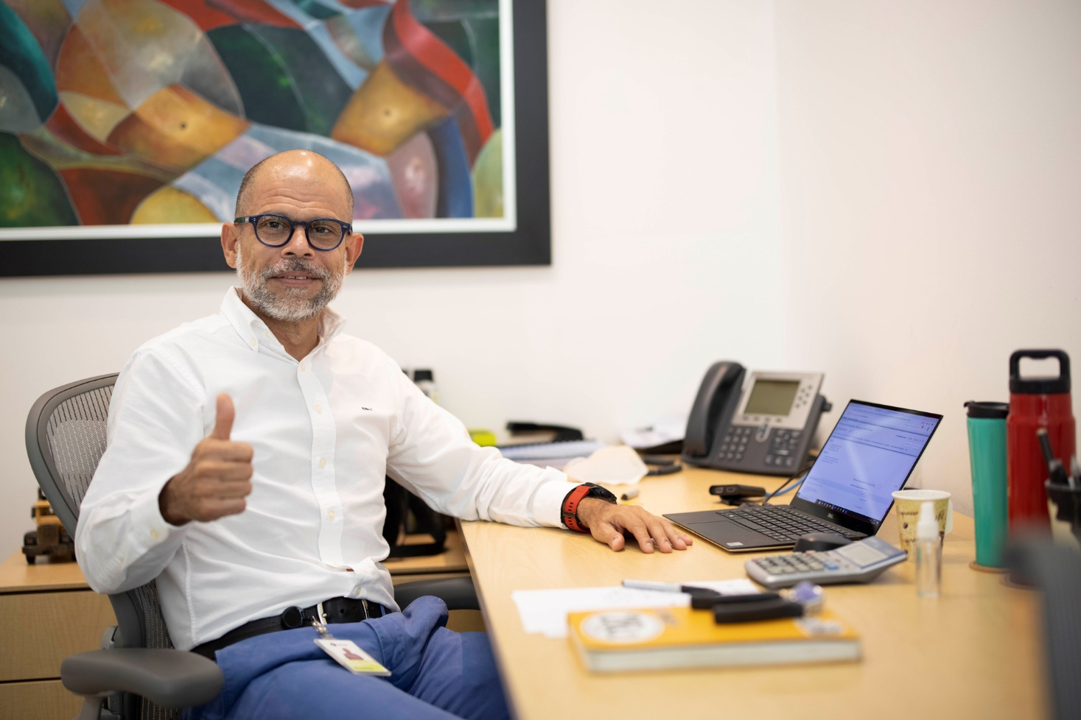

MEDIA SURVEY
RESULTS
SURINAME
AND THE CARIBBEAN

Slide 2




WHO OPINED?
Below is the number of responses obtained:
Some details:
Participation in Suriname media survey
Administrative: Around 33% of administrative staff participated.
50
45
40
Operative: Among the operatives, the participation was 4%.
35
30
25
20
15
10
5
Operatives
Administratives
Universe
Total answers

Slide 3
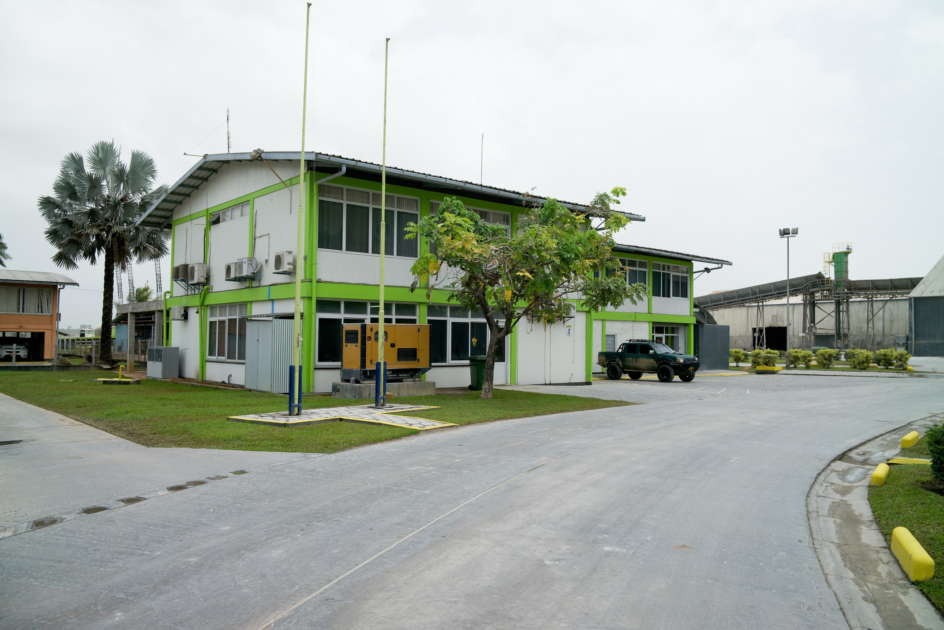
LOCAL MEDIA RESULTS

Slide 4






PREFERRED CHANNELS FOR STAYING INFORMED
This is what our people are saying:
TOP 3
CHANNELS
Digital and physical screens
0 (0 %)
Internal pressroom (NewsRoom)
1 (+ 14 %)
Newsletter To Date: Nearly 43%
of participants chose this option.
WhatsApp distribution lists
2 (+28 %)
Local newsletter (To Date)
3 (Nearly 43 %)
Caribbean Regional Newsletter
1 (+ 14 %)
Emails: Nearly 43% of participants chose this option.
Comms Argos Caribbean Mailbox
3 (Nearly 43 %)
Conversations with my leader
1 (+ 14 %)
WhatsApp distribution lists: More than 28% of voters chose this option.
Among others
0 (0 %)
0
1
2
3
Notes:
4

Slide 5


PREFERRED FORMATS FOR STAYING INFORMED
This is what our people are saying:
Images: More than 57% of participants chose this format.
Images
4 (+ 57 %)
Videos
3 (Cerca 43 %)
Graphic desings: More than 57% of participants prefer them.
Graphic desings
4 (+ 57 %)
Audios
2 (+ 28 %)
Videos: Nearly 43% prefer audiovisual content.
Conversation spaces
0 (0 %)
Text
1 (+ 14 %)
Among others
0 (0 %)
0
1
2
3
4
Fun fact…
In Suriname, with 8 votes, reflecting the total number of participants, they prefer content in static formats. On the other hand, less than half of the participants value audiovisual content.
TOP 3
FORMATS
Notes:
5

Slide 6
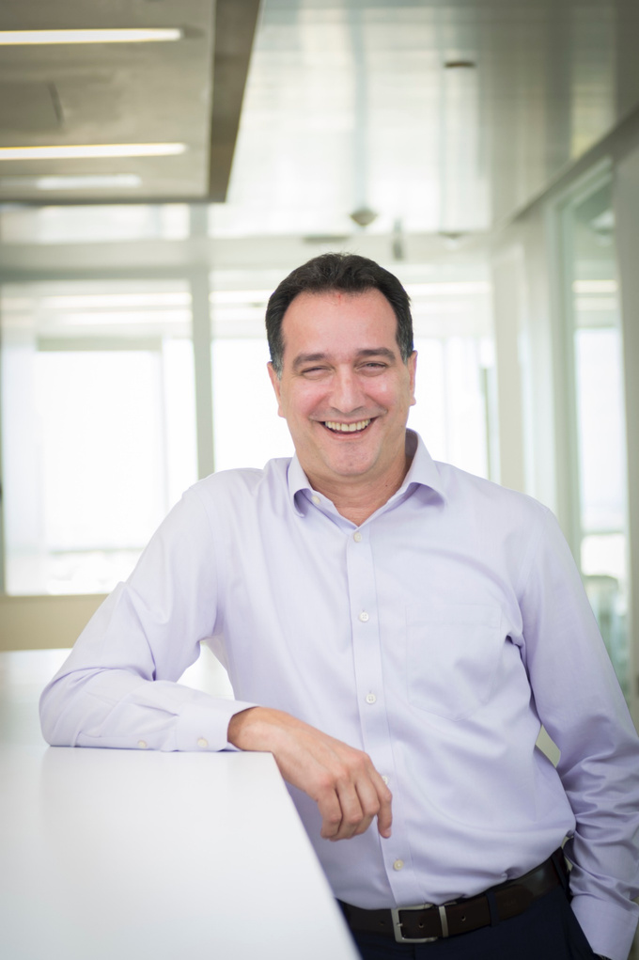
CARIBBEAN
MEDIA
RESULTS

Slide 7



ABOUT THE LAST CARIBBEAN WEBINAR
Because it was a close space in which we connected as a team.
Because I was able to learn more about the territories, their teams, and their particularities.
I feel like it didn't add value and was an unnecessary space.
I feel like it didn't add value because there's already a lot of information and other spaces.
OPINIONS
+ 57 %
About 43% saw the conversation as a close space, ideal for strengthening team ties.
Nearly 43 %
More than 57% highlight the value of discovering other territories, their projects, and their unique features.
Encouraging data!
The 100% agreed that this space adds value.
Notes:
7

Slide 8




ABOUT THE LAST CARIBBEAN WEBINAR
This is the TOP 4 topics suggested by our employees for upcoming conversations.
The team wants to delve deeper into the strategic aspect without losing sight of the bigger picture. They prefer to cover all topics in a general way, while prioritizing relevant topics. Nearly 100% of participants chose these two options.
3 votes
3 votes
2 votes
2 votes
50%
45%
40%
35%
There is a clear interest in learning from the "how" and the "who." Success stories and knowledge transfers with external stakeholders are inspiring in Suriname. More than 50% of participants chose these two options.
30%
25%
20%
15%
10%
5%
0%
Strategic topics
All topics
in general
Success cases
Knowledge transfer with external guests

Slide 9







ABOUT THE LAST CARIBBEAN WEBINAR
This is how the participants rated us.
Of the five indicators that could be rated, these were the most outstanding:
*The highest rating was 5 and the lowest was 1.
Top rated aspects
70% of participants highly rated the speakers knowledge (3.6) and the ease of accessing the platform (3.6)!
4
Areas for improvement
Nearly 65% ​​of participants positively rated the relevance of the topics (3.3) and the availability of space (3.3). The topics can be tailored to audience interests in future discussions.
3.5
3
2.5
2
1.5
1
Critical areas
Only 54% approved of the translation and interpretation services (3.1)! Although more than half were satisfied, it is important to continue strengthening the translation experience.
0.5
0
Relevance of the topics
Availability of rooms and transmission spaces
Participation of the speakers
Possibility of activating interpretation in other languages
Ease of access to the platform
Translation quality

Slide 10
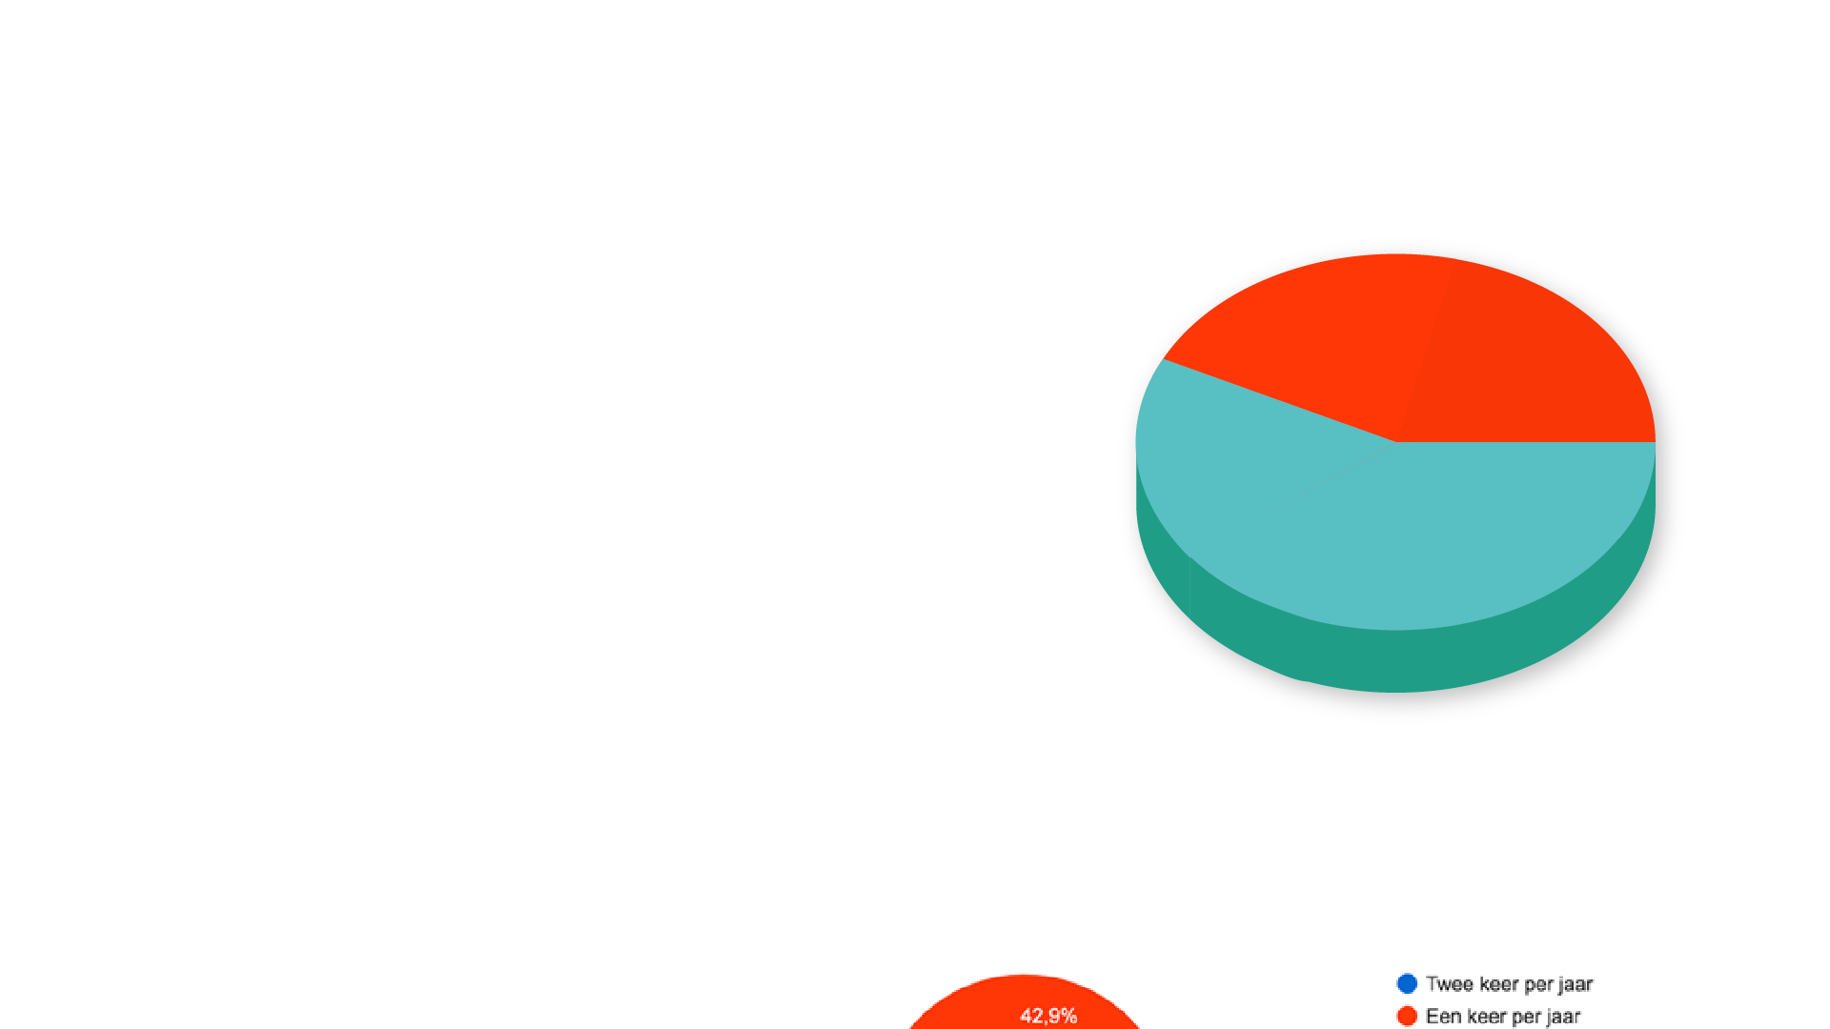

ABOUT THE LAST CARIBBEAN WEBINAR
FREQUENCY
Nearly 43 %
+ 57 %: Twice a year!
Nearly 43 %: Once a year is fine
+ 57 %
Our employees value these spaces!
No one rules out continuing to connect regionally through the conversations. 100% of participants, across different frequencies, value them and want them to continue.
Twice a year
Once a year
None, corporate spaces are sufficient
Every two years

Slide 11



ABOUT THE REGIONAL NEWSLETTER BY GARY DE LA ROSA
This is what our people are saying:
It is a useful medium with relevant information about the performance of the region and the company.
It's interesting, but two a year is enough.
It is a redundant medium to other content we receive in the company
+ 14 %
Does not add value
+ 85 %
100% of participants found this newsletter useful and relevant.

Slide 12


ABOUT THE ARGOS CARIBBEAN COMMUNICATION MAILBOX
This is what our people are saying:
+14% are very satisfied:
it's reliable and relevant.
+ 14 %
+ 85 %
+85% are satisfied:
They recognize the value of this medium.
No one considers it a medium that does not add value, we are doing well!
The satisfaction rate is 100%!
Very satisfied
Unsatisfied
Satisfied
Very unsatisfied
Neutral

Slide 13

SOME OPINIONS
This is what our people are saying:
“SOMS WEL EN SOMS WEER NIET. MEN IS NIET OPEN NAAR MIJ TOE”
“SOMETIMES THEY DO AND SOMETIMES THEY DON'T. ONE IS NOT OPEN TO ME”
“A veces lo hacen, a veces no. No son transparentes conmigo”
“MAG NIET VERZADIGEN, ER IS VEEL INFORMATIE”
“THEY SHOULD NOT SATURATE, THERE IS A LOT OF INFO”
“No deben saturar, hay mucha información”
“ZE DOEN HET GEWELDIG”
“THEY DO GREAT”
“Lo hacen genial”
Notes:
13

Slide 14

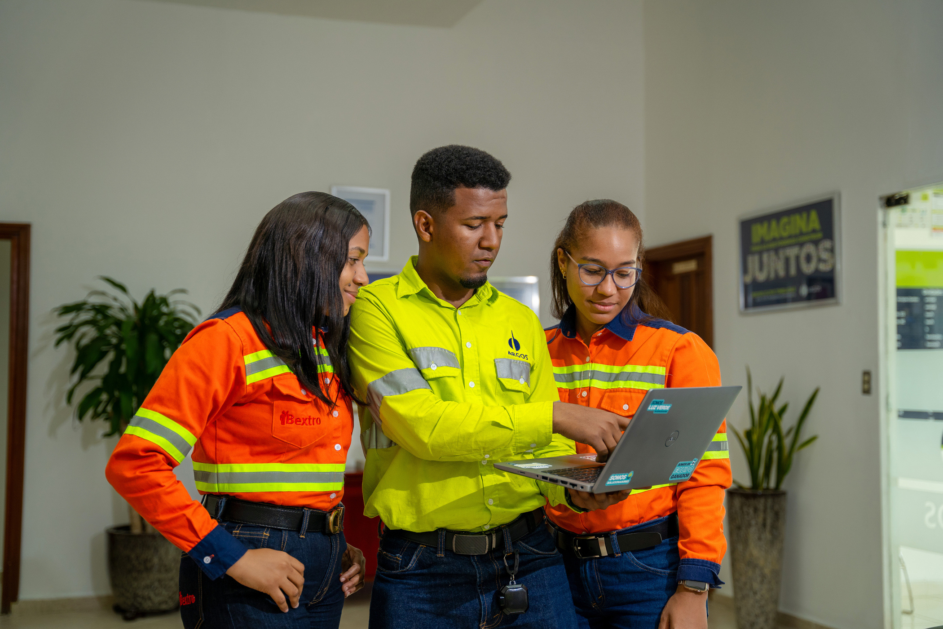

CARIBBEAN REGIONAL MEDIA AND CHANNELS

Slide 15

MAIN FINDINGS CARIBBEAN
Principales hallazgos caribe
GENERAL REFLECTIONS:
Videos are the preferred format, text is the least chosen.
Operation leaders are one of the main communication channels.
Digital screens less valued
WhattsApp as most prominent channel (- in Puerto Rico).
ConsideraTIONS:
Do not overwhelm.
Leaders' spaces with local allies.
Short and clear content.
French Guayane / Need to connect and communicate.
Digital screens go out. Each territory validates its functionality and budgets for 2026 if necessary.
REGIONAL MEDIA AND CHANNELS:
Webinar: Entertaining content and stories of trajectory. As well as strategic issues and success stories. Positive feedback from the panelists.
Regional Newsletter by Gary de la Rosa: Overall, it was very positive perception.
In general, it is very well rated.
formats:
Audiovisual (all).
Conversations (all).
Suriname reading and creative images (language - local translator).
Notes:
Validar con Rachel el tema de la traducción local. Percepción y otras alternativas.

Slide 16

CARIBBEAN MEDIA strategy
PUBLIC | MEDIA/CHANNEL | OBJECTIVE | FORMAT | TONE | FREQUENCY | KPI | RESPONSIBLE
Administratives Operatives | Caribbean Conversation | Discuss relevant concerning the Caribbean Region. | Conversation / virtual | Fresh and close to connect employees with other teams and territories in the region. | Annually | • Number of attendees • Satisfaction surveys | Communications
Administratives | Communications Argos Caribbean Mailbox | Communicate in a timely manner relevant company or regional news and milestones. | Mail, screens, (local management), We are Caribbean section or WP allied GH / Ecard, video or audio | Corporate and interactive | As required | Open and click-through rates | Communications
Administratives Operatives | Caribbean Regional Newsletter | Position Gary as a spokesperson for the milestones and relevant events of the region. | • Email Gary • WhatsApp allies GH • Digital Screens (local management) | Corporative and close | Half-yearly | • Viewing rate • Perception surveys | Communications
Notes:
Enfoque en fortalecer los medios directos con líderes y aliados locales

Slide 17
PUBLIC | MEDIA / CHANNEL | OBJECTIVE | FORMAT | TONE | FREQUENCY | KPI | RESPONSIBLE
Leaders | Caribbean WP leaders distribution list / Green Light Conversations | Deliver tools to leaders aligned with their role and the business strategy. | Conversations with Green Light / Video | Close and interview type | Quarterly | Viewing rate | Communications
Leaders | Caribbean leaders distribution list / Tools | Deliver tools to leaders aligned with their role and the business strategy. | Podcast, video, audio, among others | Dynamic, corporate and close | Fortnightly | Viewing rate WhatsApp surveys | Communications
Leaders | Caribbean leaders distribution list / News | Informing leaders of relevant company events. | Video, infographics, ecards, audios, among others. | Dynamic, corporate and close | On demand | Viewing rate | Communications
Human Resources Allies | Caribbean allies WhattsApp group | Timely reporting of regional and corporate news and campaigns. | Video, infographics, ecards, audios, among others. | Dynamic, corporate and close | On demand | Viewing rate | Communications

Slide 18
TIMELINE CARIBBEAN MEDIA
Conversatory
Caribbean
Newsletter
Caribbean Regional #2
May
June
July
August
September
October
November
December
Conversations
Green Light #1
May 26th
Newsletter
Caribbean Regional #1
June 16th
Conversations
Green Light #2
Conversations
Green Light
#3

Slide 19
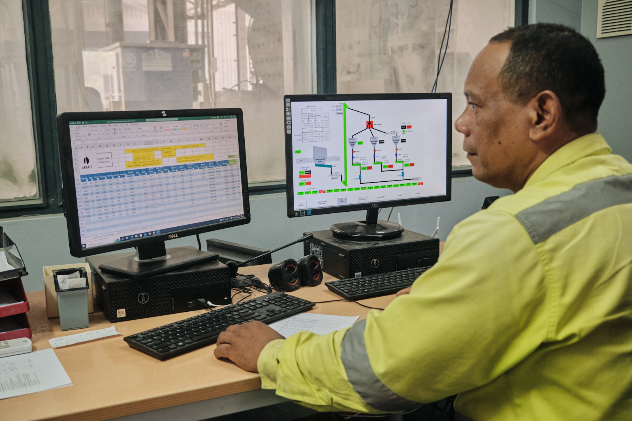

FINDINGS BY TERRITORY
SURINAME
The survey had a positive participation.
WhatsApp is the medium with the highest acceptance.
The Caribbean Webinar is well received as it prioritizes strategic issues and success stories.
It is necessary to create spaces for the projection and participation of collaborators.
The regional newsletter is well accepted.
They prefer to receive content in audiovisual format.
The local and regional mailboxes are not so highly valued.

Slide 20
MEDIA STRATEGY SURINAMe
PUBLIC | MEDIA /CHANNEL | OBJECTIVE | FORMAT | TONE | FREQUENCY | KPI | RESPONSIBLE
Administratives Operatives | To Date Newsletter | Keep employees updated on news and milestones related to operations. | Local mailbox Physical billboards (local management) | Corporate and close | Bimonthly | Open and click-through rates Viewing rate | Communications Human Resources of Suriname
Administratives Operatives | Animated video To Date newsletter | Keep employees updated on news and operational milestones. | WP mailing lists Digital billboards (local management) Direct spatial projection | Close and fresh. | Bimonthly | Number of deliveries Programming | Communications
Administratives Operatives | Project and campaign communications. | Mobilize pertinent regional and local initiatives and campaigns. | Community mailbox Digital billboards (local management) WP mailing list | Corporate and close | On demand | Sending rate vs. views | Communications

Slide 21
TIMELINE to date - suriname
FIRST EDITION
JUNE
JULY
Week 1
Week 2
Week 3
Week 4
Week 1
Week 2
Week 3
Week 4
Receiving of
information
Receiving of
information
Receiving of
information
Structuring
of content
Desing
Design modifications
Sending the
newsletter
1st review
Review by
Com. Caribbean
2nd review
Review by
Com. Caribbean
4th review
Final local
review
Sending animation
2nd review
Local
review
3rd review
Local review
Production of the
animation in
design
Structure
script for
animation

Slide 22
TIMELINE to date - suriname
SECOND EDITION
AUGUST
SEPTEMBER
Week 1
Week 2
Week 3
Week 4
Week 1
Week 2
Week 3
Week 4
Receiving of
information
Receiving of
information
Receiving of
information
Structuring
of content
Desing
Design modifications
Sending the
newsletter
1st review
Review by
Com. Caribbean
2nd review
Review by
Com. Caribbean
4th review
Final local
review
Sending animation
2nd review
Local
review
3rd review
Local review
Production of the
animation in
design
Structure
script for
animation

Slide 23
TIMELINE to date - suriname
THIRD EDITION
OCTOBER
NOVEMBER
Week 1
Week 2
Week 3
Week 4
Week 1
Week 2
Week 3
Week 4
Receiving of
information
Receiving of
information
Receiving of
information
Structuring
of content
Desing
Design modifications
Sending the
newsletter
1st review
Review by
Com. Caribbean
2nd review
Review by
Com. Caribbean
4th review
Final local
review
Sending animation
2nd review
Local
review
3rd review
Local review
Production of the
animation in
design
Structure
script for
animation

Slide 24
TIMELINE INTERNAL MEDIA
Socialization
media strategy
May
June
July
August
September
October
November
December
Campaig media
strategy
To Date
To Date
To Date

Slide 25
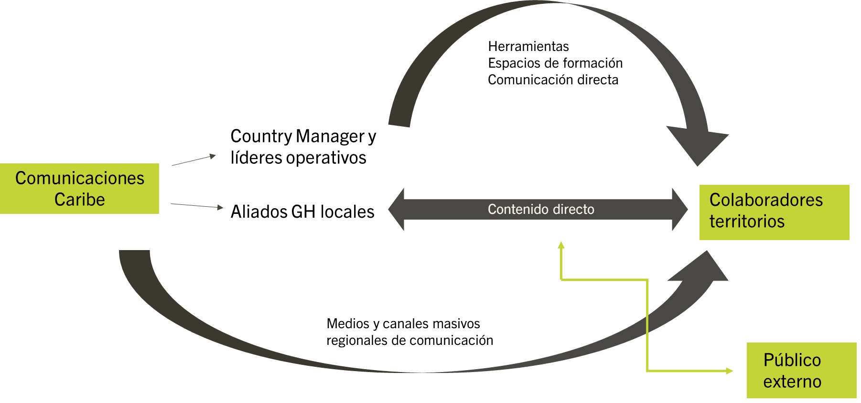
INTERNAL COMMUNICATION SCHEME
Tools
Training spaces
Direct communication
Country Manager and operational leaders
Caribbean
Communications
Local HR allies
Employees
territories
Direct content
Regional mass media and communication channels
External
public

